Slide 1

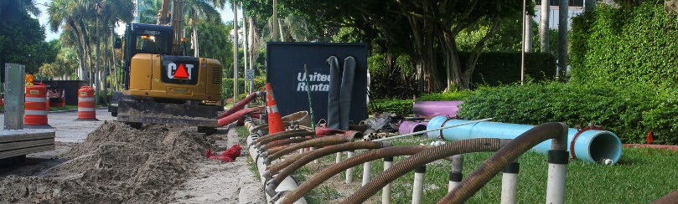
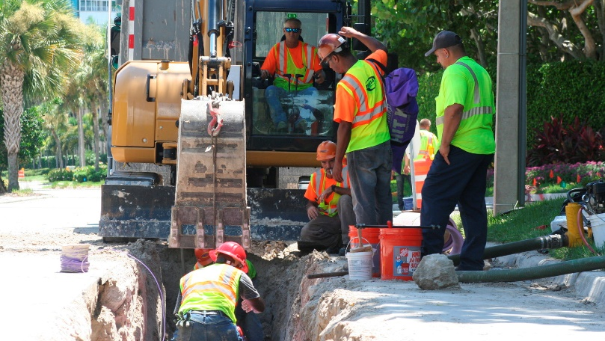

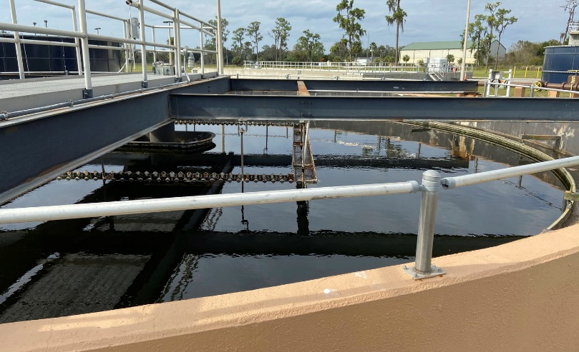
Rockland Sewer I/I Project Summary
February 22, 2024

Slide 2
2021 SSES Report & Sewer System Rehabilitation Project Summary
Total identified I/I is approximately 227,725 gallons in the project area, according to the 2021 report.
Infiltration removal is typically limited to 50-90 percent due to the potential for migration of the flow from one repaired defect to a nearby defect that may not have been identified. A 50% removal rate is assumed as a conservative approach.

Slide 3
I/I Control Plan
15 Year Plan ​
Year 1 – Flow & Rainfall Monitoring and Groundwater Analysis​
Year 2-4 – Infiltration​
Year 5 – Inflow (Yr 2-4 Project Area)​
Year 6 – Rehabilitation Project (Yr 2-5 Project Area)​
Repeat – Years 2 to 6

Slide 5
Annual I/I and O&M Program

Slide 6
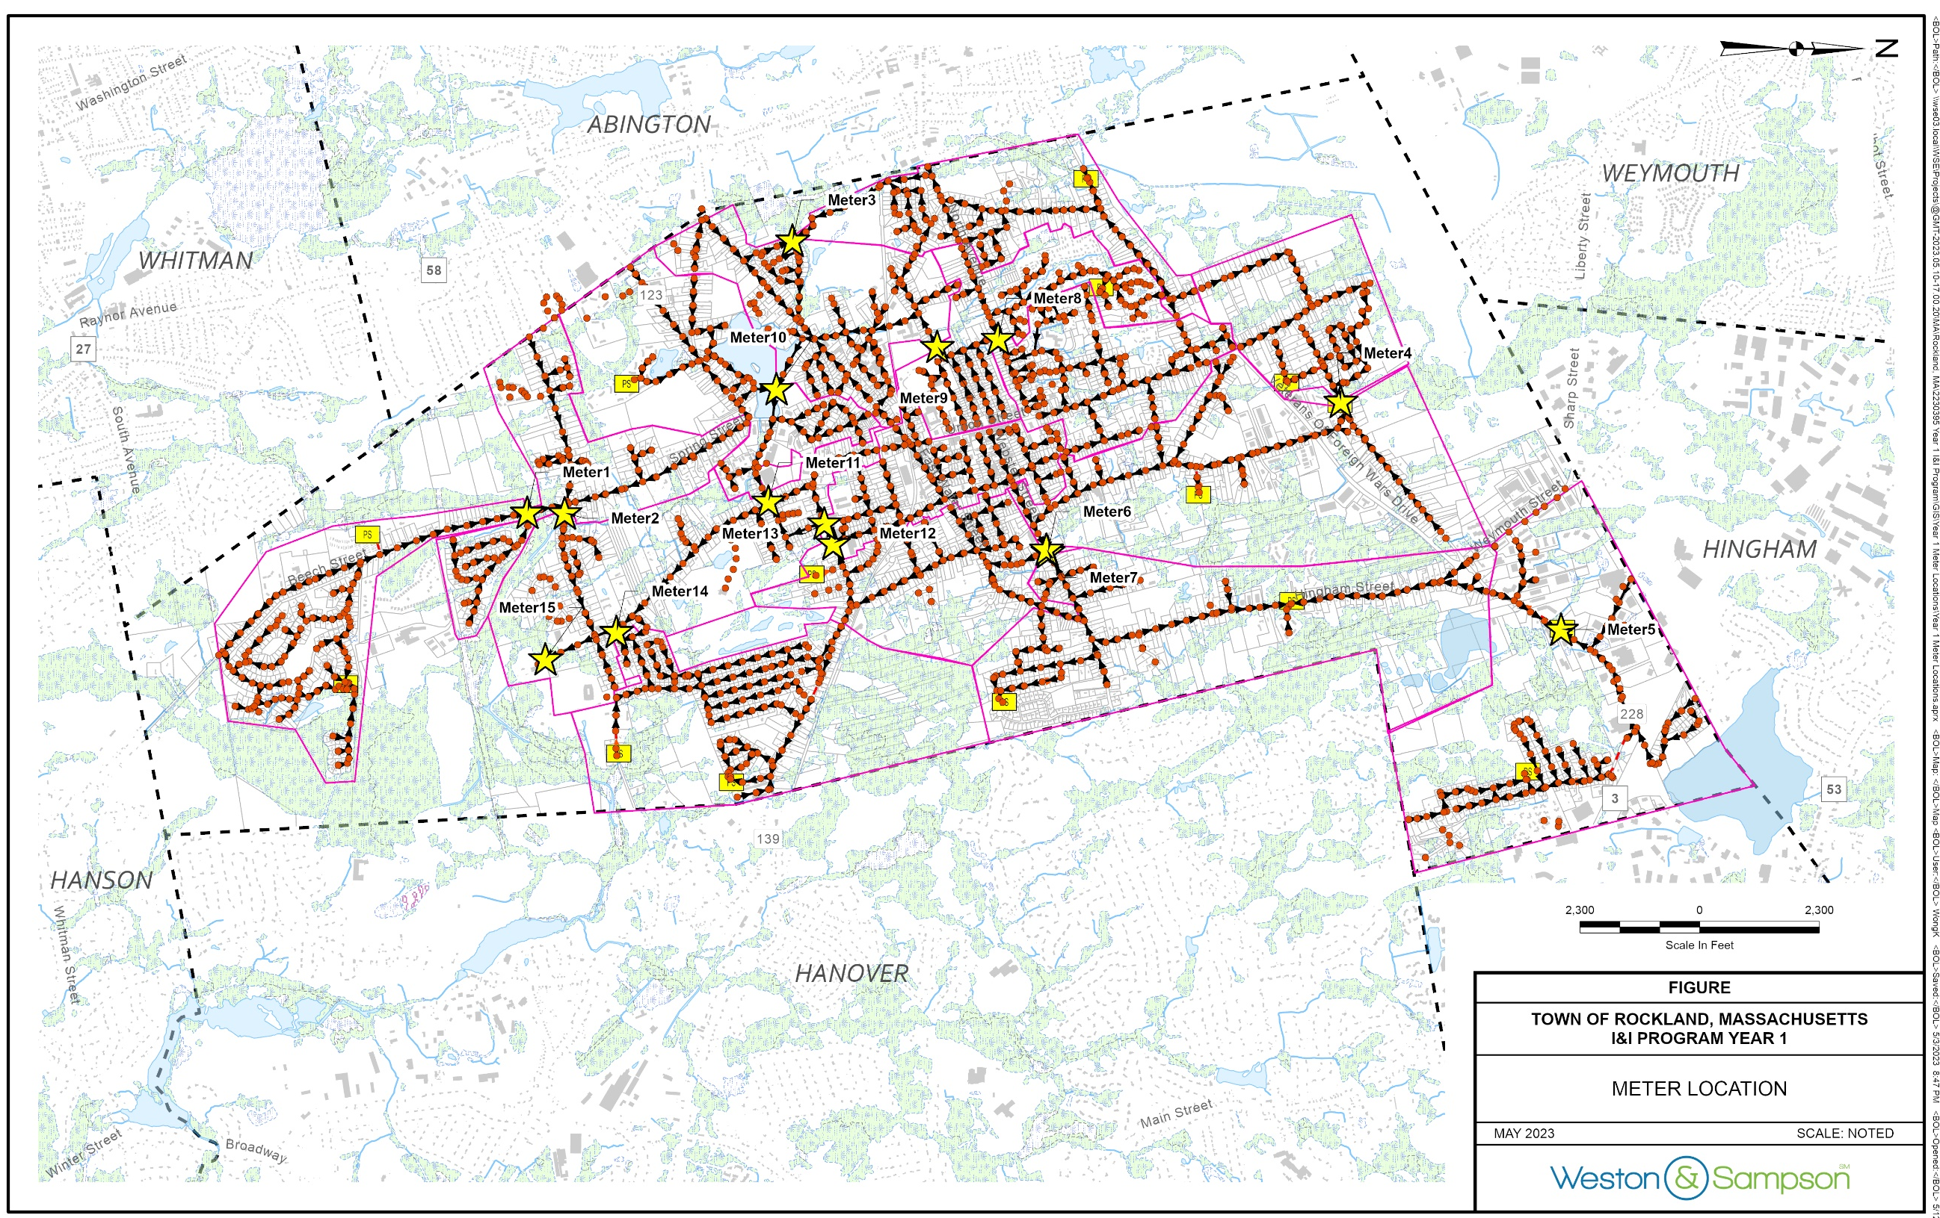
Year 1 - Flow Metering and I/I Analysis
15 meters, 3 Groundwater Gauge, and 1 Rain Gauge were installed April 2023
Monitoring period - 10 weeks

Slide 7
Metering Study Results
Generally, infiltration removal is typically limited to 50-90 percent, while inflow removal can be completely (100%) removed.
Recommended prioritize subarea 6 and 11 for further investigation (Project Area for Year 2 Infiltration)
Followed by subareas 9 and 13 (Project Area for Year 3 Infiltration)

Slide 8
I/I Annual Program – Year 2 Infiltration
Subarea 6 and 11 were prioritized for further inspection based on Year 1 metering result
Approximately 37,300 linear feet (LF) of sewer pipes and 172 manholes were inspected
Inspection Result
Observed Infiltration = Approx. 45,000 GPD
Unidentified Service Flow (Suspected I/I) = Approx. 110,000 GPD

Slide 9
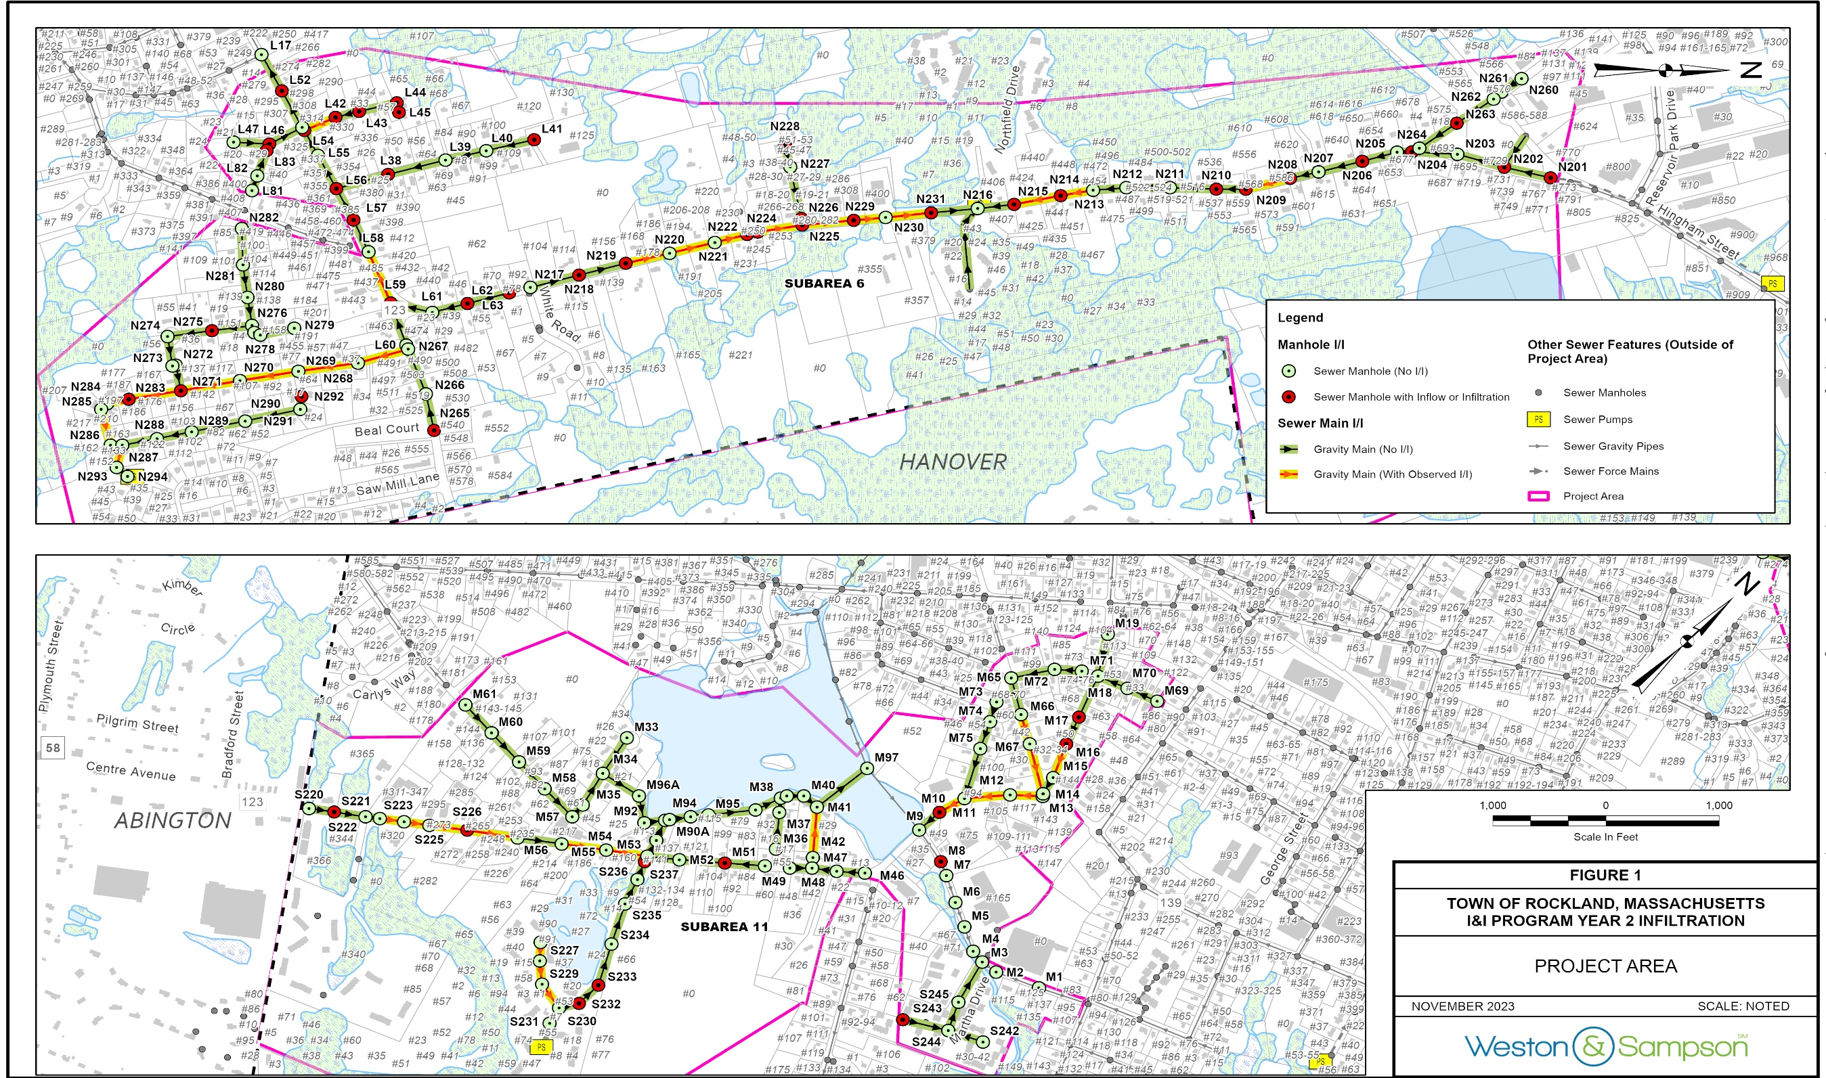

Slide 10
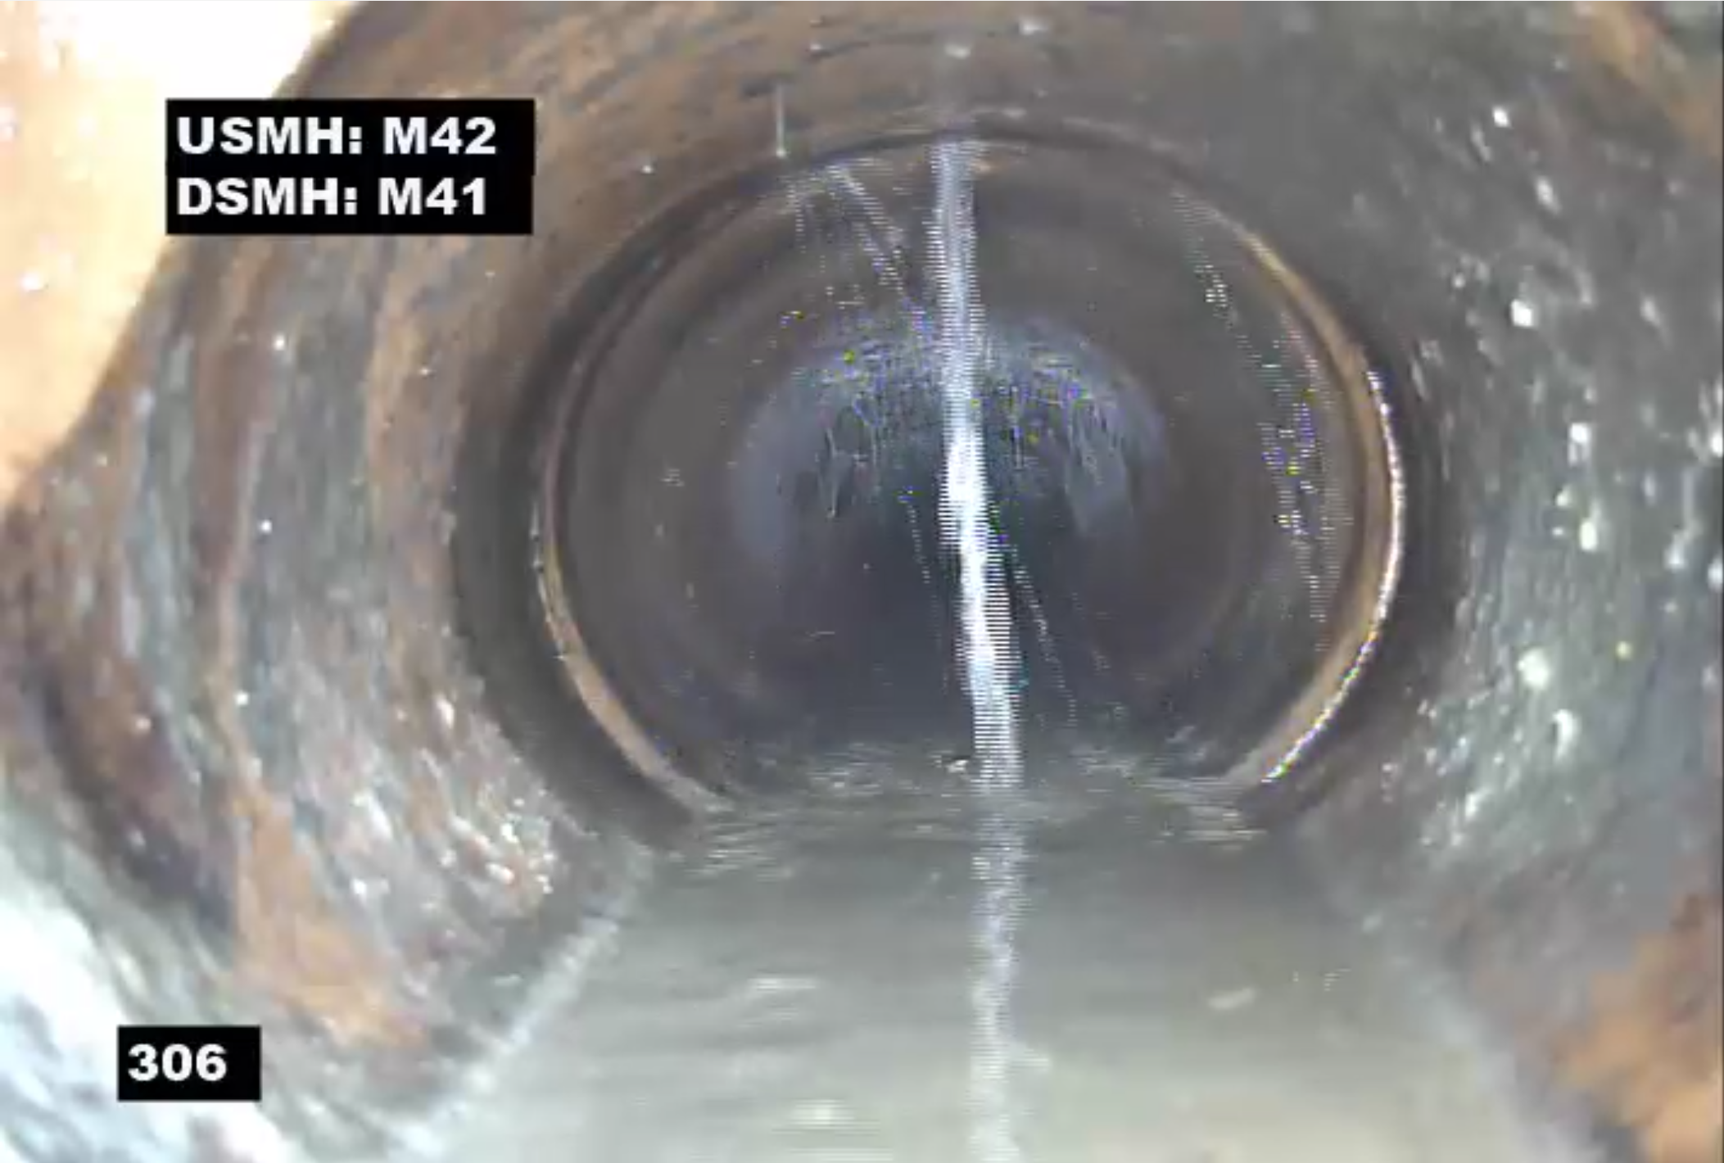
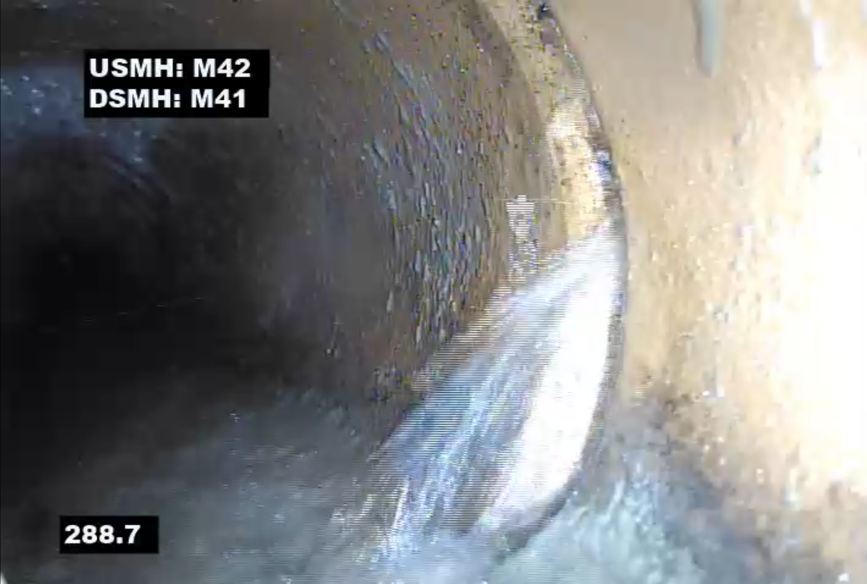
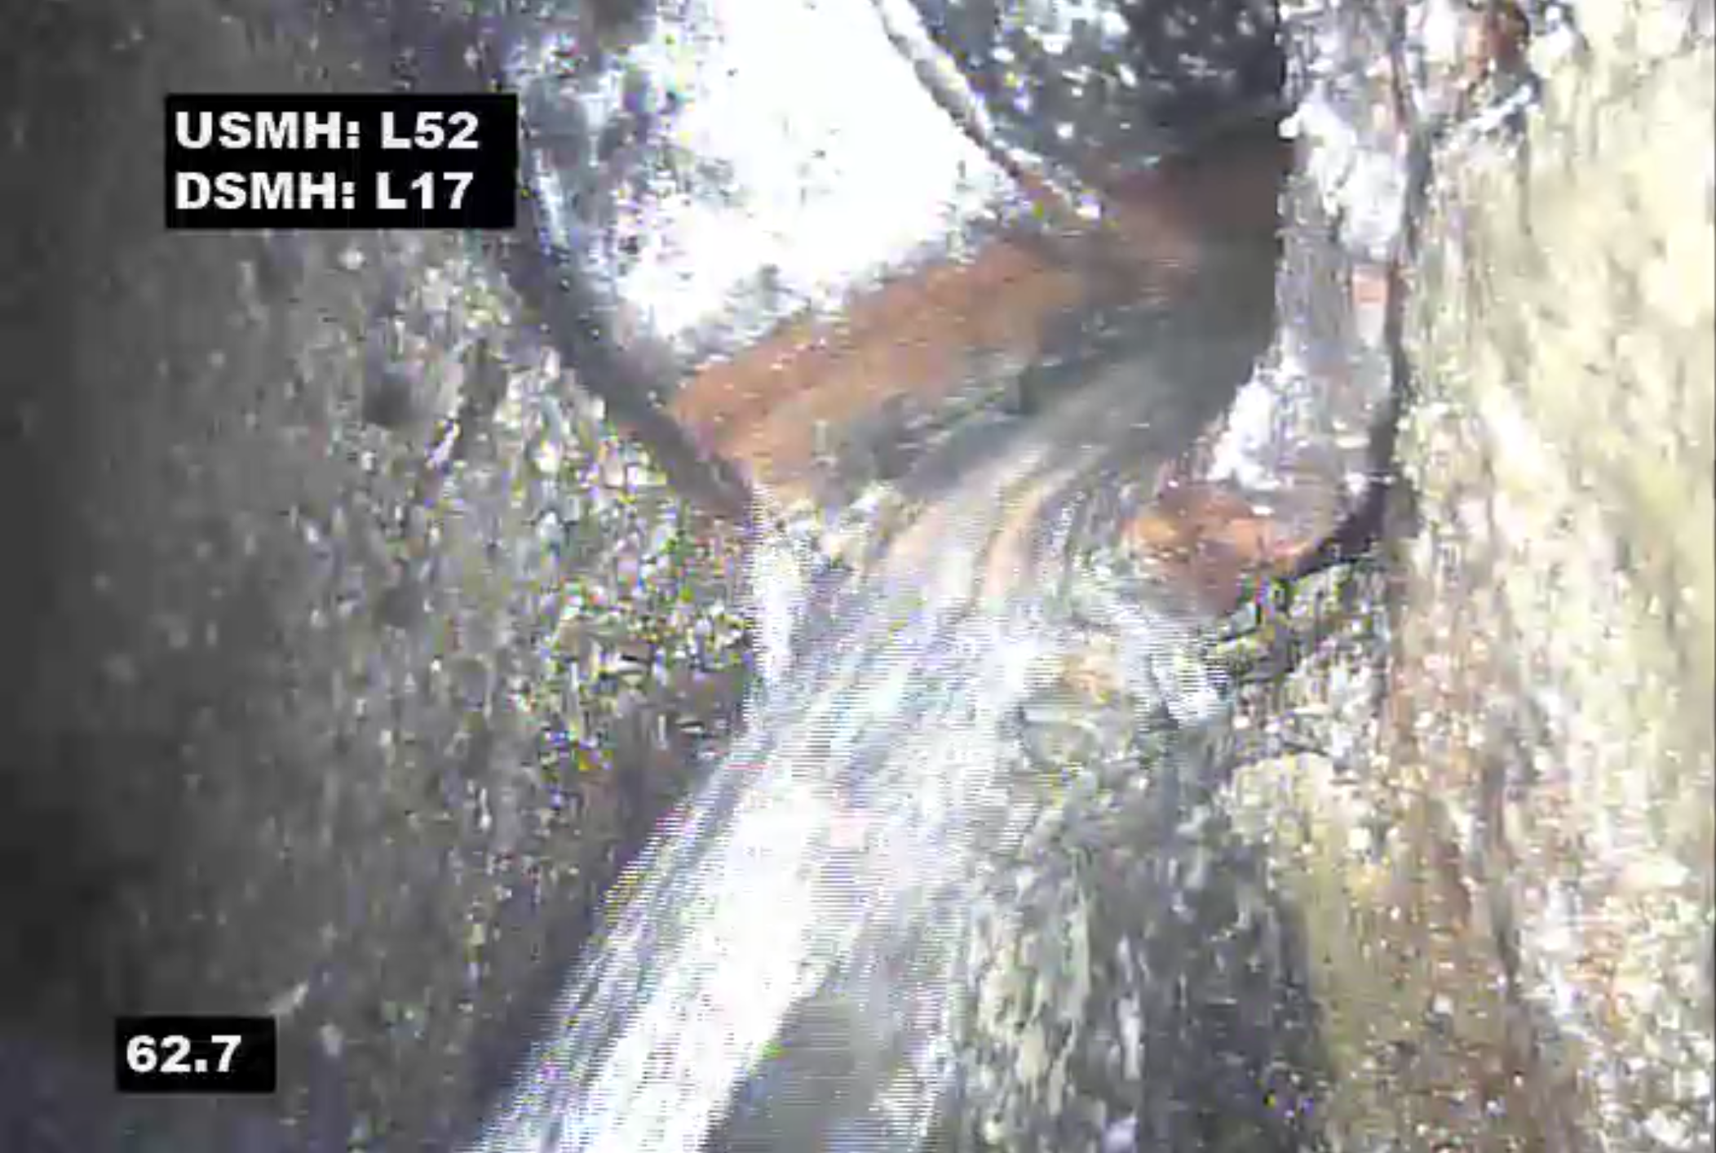
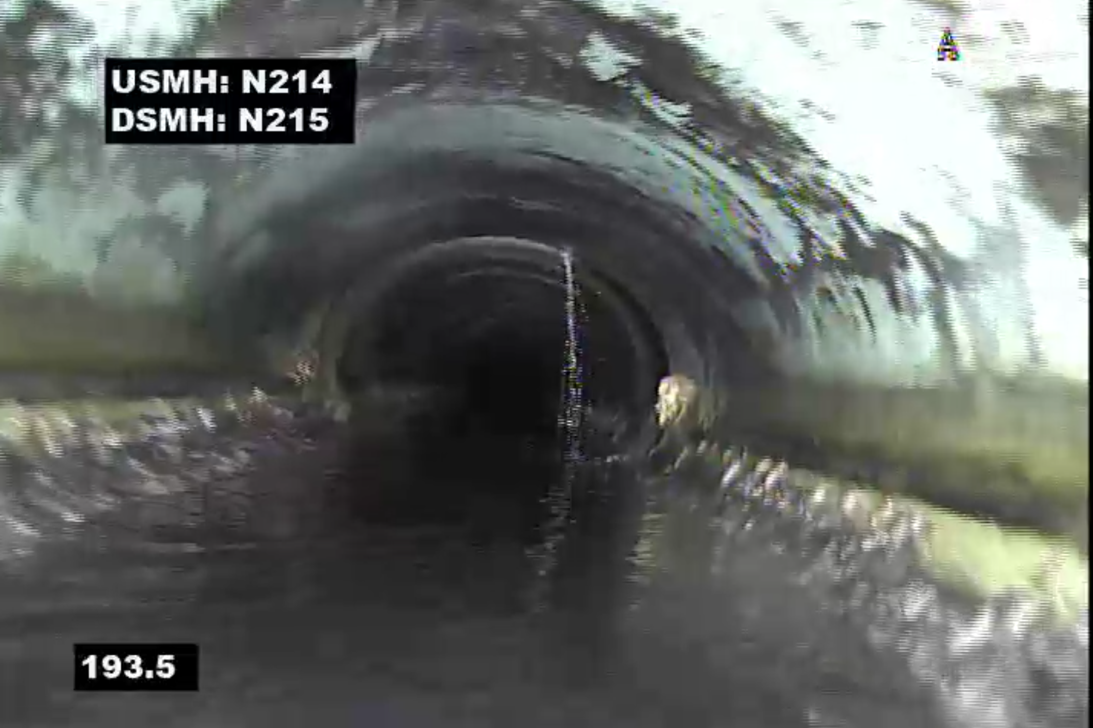
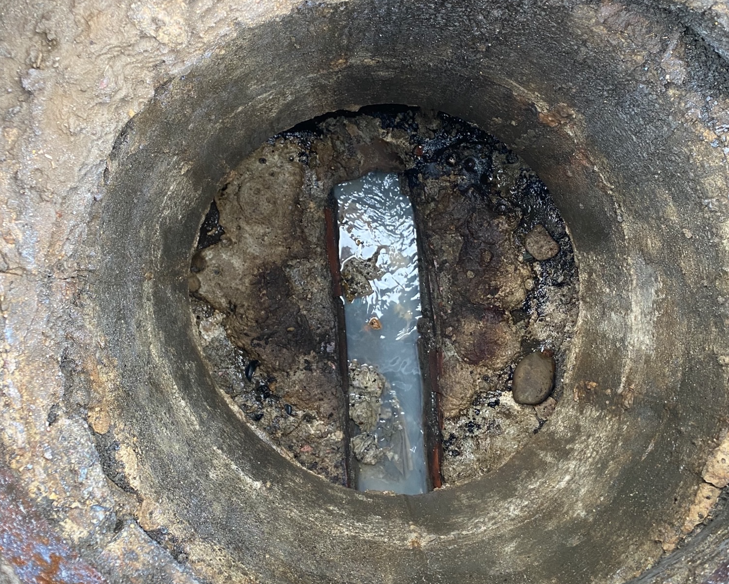
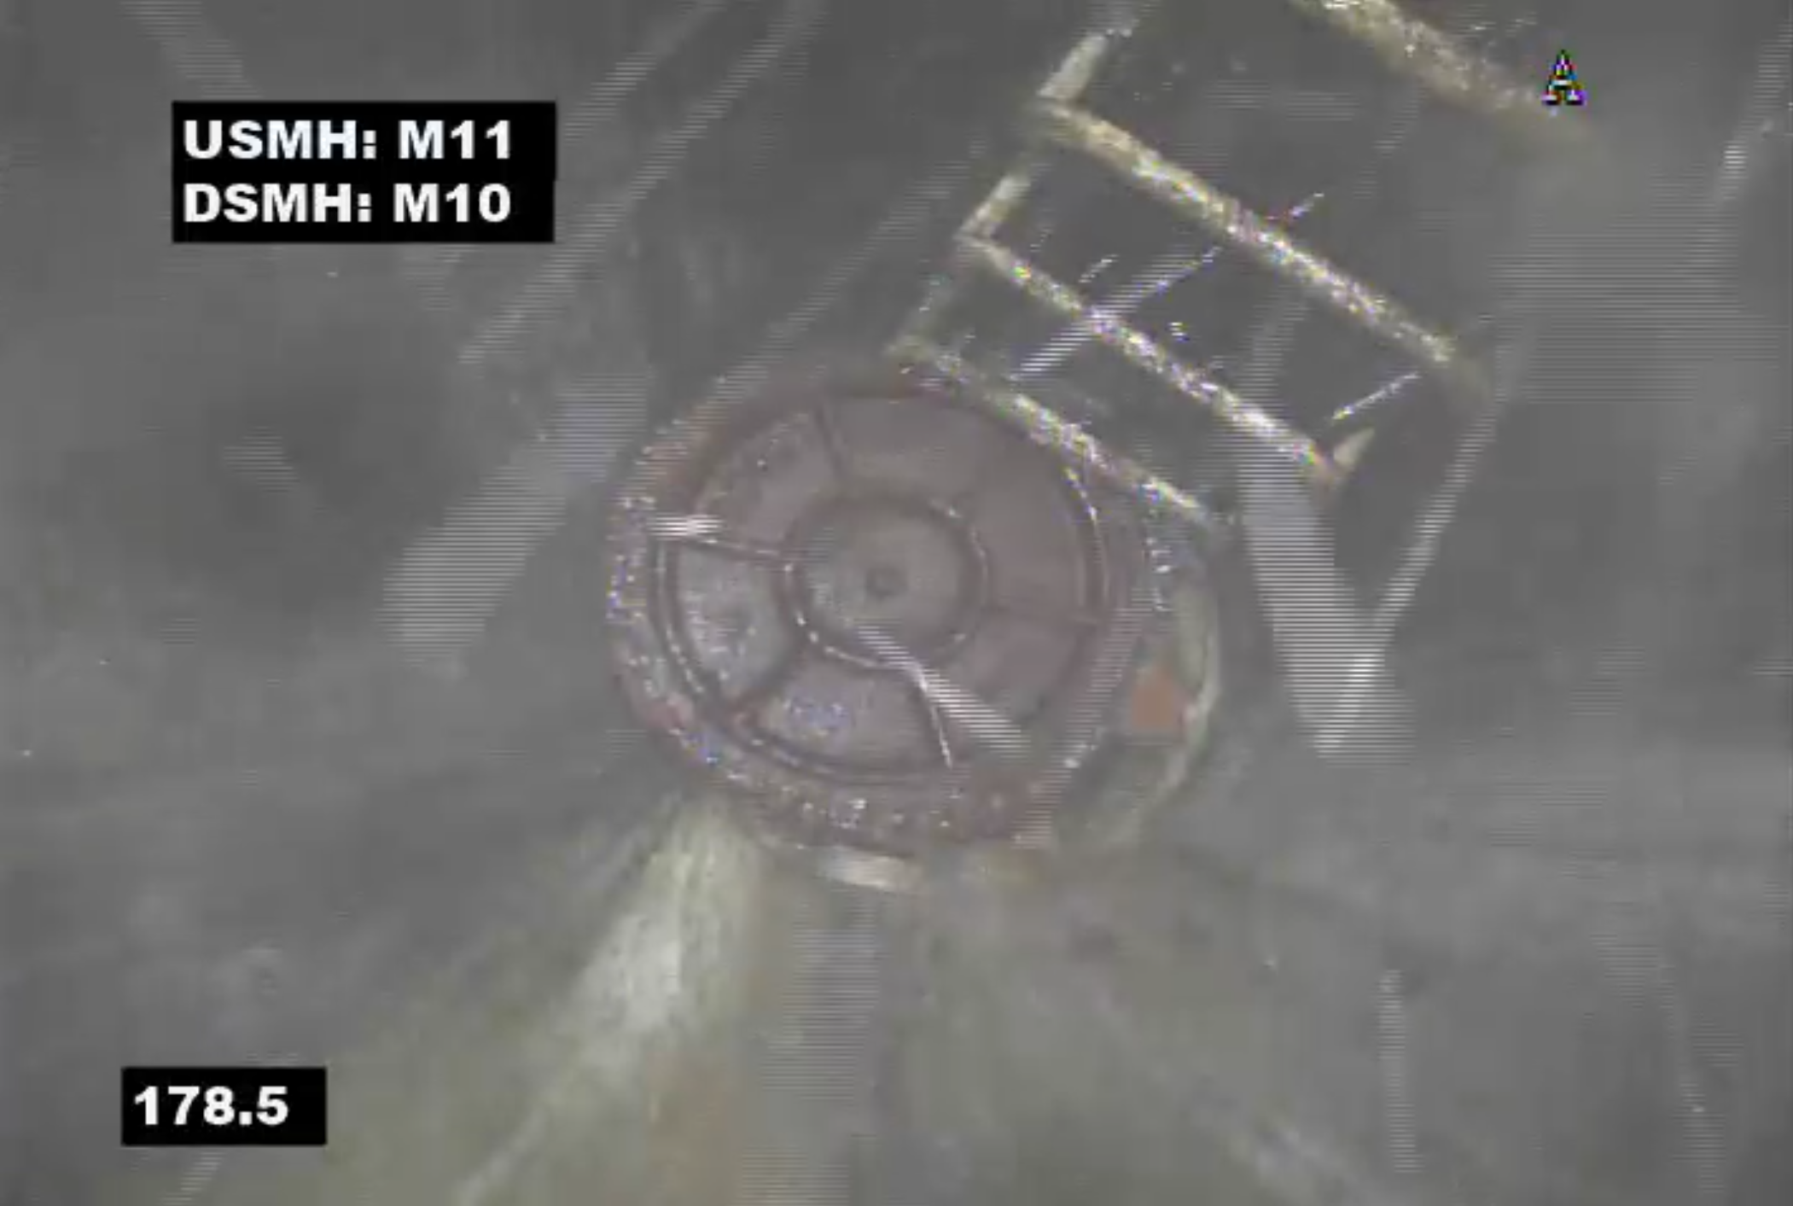
Infiltration @ Joint: Approx. 7200 GPD
Infiltration @ Joint: Approx. 7200 GPD
Infiltration @ Joint: Approx. 5760 GPD
Infiltration @ Joint: Approx. 1440 GPD
Manhole with signs of infiltration
Infiltration/Inflow @ Manhole Cover

Slide 11
I/I Annual Program – Year 3 Infiltration
Subareas 9 and 13 are selected as the project area for Year 3 Infiltration
Approximately 40,500 linear feet (LF) of sewer pipes and 210 manholes will be inspected
Anticipated Schedule
Manhole Inspection: March
CCTV Inspection: April

Slide 12
I/I Annual Program – Future Work
Ahead of Schedule – Year 3 Infiltration Project is planned for Spring 2024
To reevaluate the Annual Program schedule after the completion of Year 3 Infiltration work. Town may consider performing sewer rehabilitation sooner or continue to Year 4 Infiltration.

Slide 13
Sewer Rate Study

Slide 14
Rate Study Results Overview
Operation & Maintenance (O&M) expenses are projected to increase by approximately 3% annually
In the next 10 years, the Town’s Sewer Department is expected to spend nearly $9 million annually on capital improvements
Mostly for WWTF Upgrade
Some capital improvement projects will be fund by ARPA monies
Targeting retained earnings at 15% of Budget
Urgency to build up reserve to fund WWTF upgrade project

Slide 15
Recommended Rate Increases
Through careful evaluation and analysis, a proposed rate increase plan is submitted to the Sewer Commissioners for review and comments. The recommended 15-year rate increase plan:
First 8-year period, a 10% increase per year
Followed by a slower 7-year period increase

Slide 16
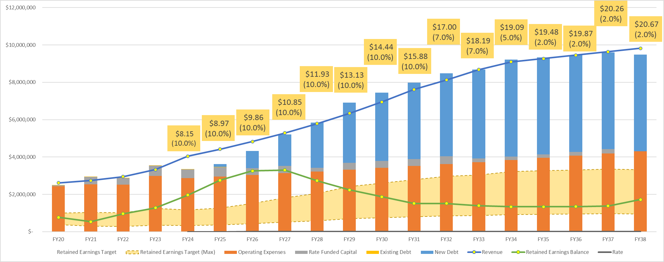
Projected Sewer Cash Flow – with recommended rate changes

Slide 17

Thank you!
Questions?
westonandsampson.com

