Slide 1

Brookfield Properties/South Weymouth Naval Air Station (SWNAS) Development
Meeting with Town, Tetra Tech and Weston & Sampson
February 22, 2024
Kevin Olson, PE
Adam Higgins, PE

Slide 2
Presentation Overview
Existing Wastewater System
Comprehensive WWTP Assessment and Evaluation Summary
WWTP Flows
Town Sewer Moratorium and Pending Sewer Connections
Comprehensive Wastewater Management Plan (CWMP) Summary
EPA Order Overview
Proposed WWTP Upgrades/Approach
Groundwater Discharge and Flow Shedding Options Overview
Questions & Discussion

Slide 3
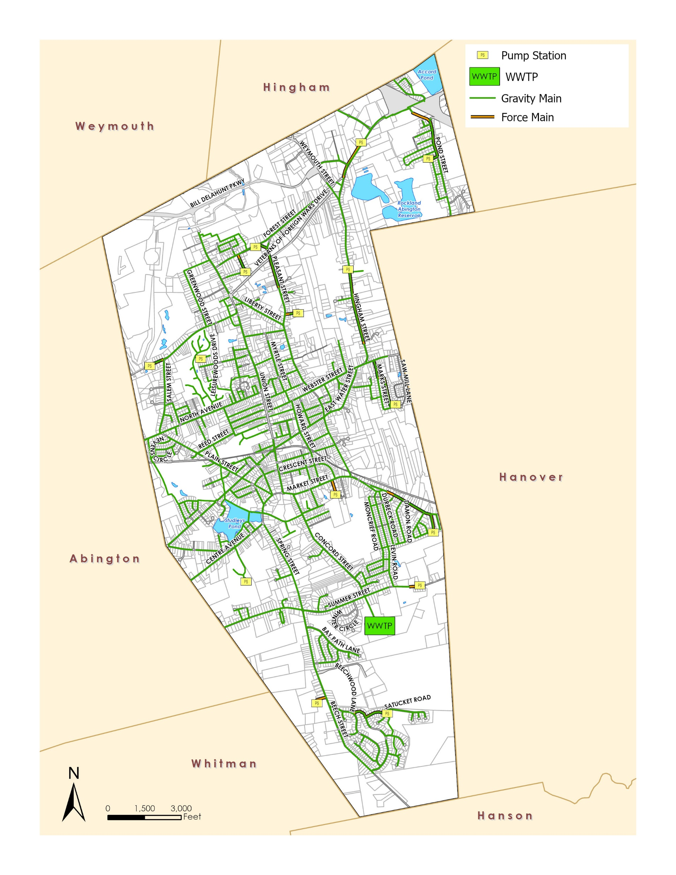
Existing Wastewater Infrastructure
Approximately 57 miles of gravity sewer
Approximately 4 miles of force main
13 pump stations
Serves approximately 18,000 customers from Rockland and small parts of Abington
One WWTP with NPDES Permit flow limit of 2.5 MGD
Surface water discharge to stream that feeds the French Stream
New strict seasonal TP Limit of 0.1 mg/L
Likely to get a numerical TN limit in future permit

Slide 4
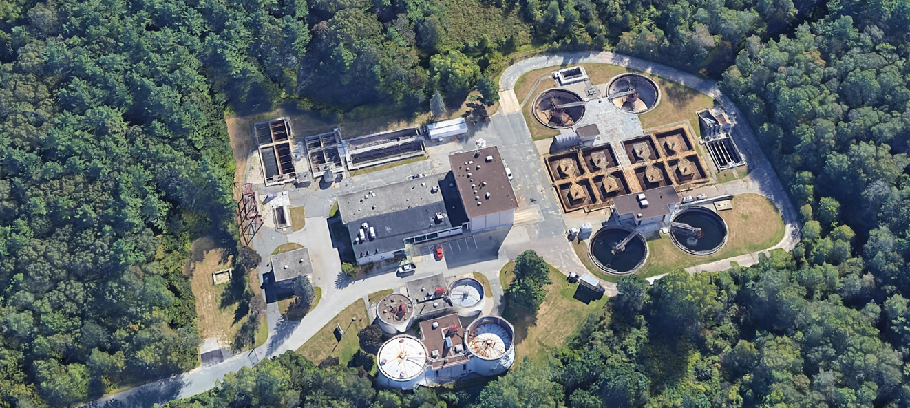
WWTP Assessment and Evaluation – Completed in April 2021

Slide 5
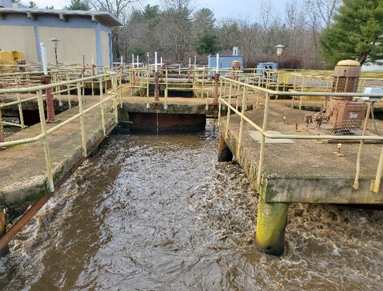
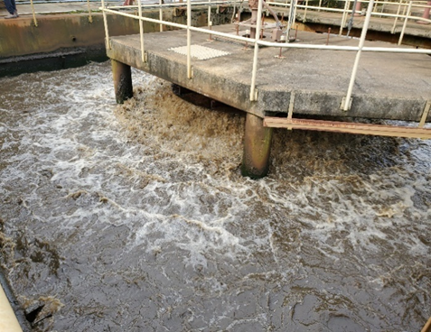
WWTP Concerns/Drivers

Slide 6
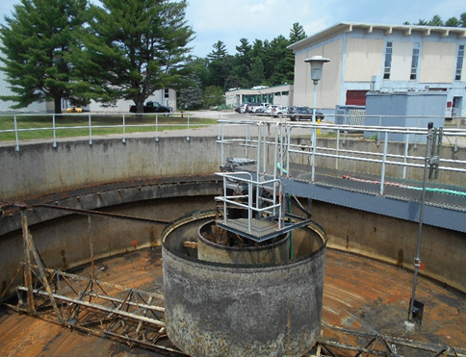
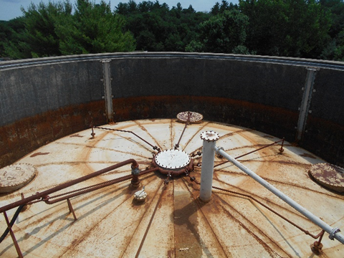
WWTP Concerns/Drivers

Slide 7
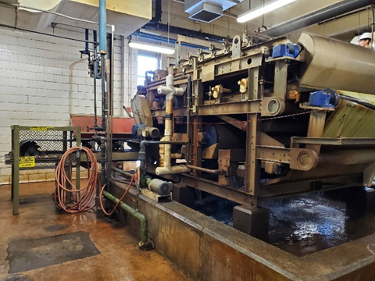
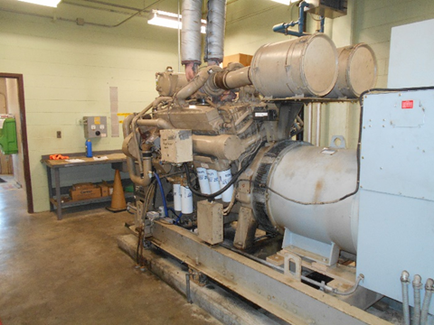
WWTP Concerns/Drivers

Slide 8
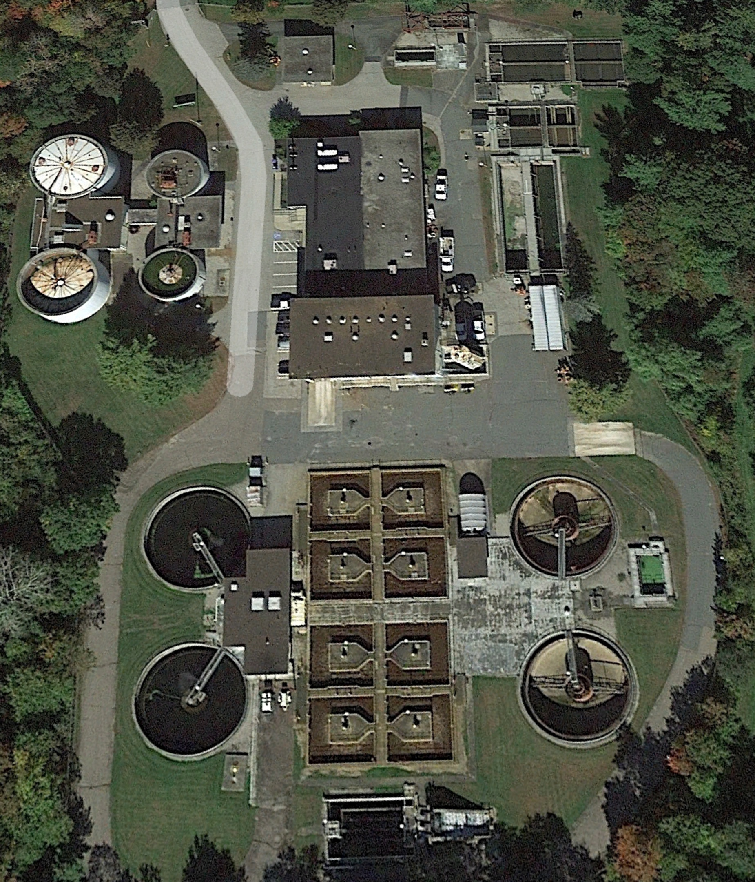
WWTP – Scope of Improvements
New screening and grit facility
Influent pump station modifications
Primary clarifier modifications
Secondary system modifications
Secondary clarifier modifications
Tertiary system and building
Chemical building
Chlorine contact tanks and effluent pump station
Sludge storage tanks
Administration building
Garage and electrical building
General

Slide 9
2020 – 2022 WWTP Flows
Notes:
Still having high flow issues with the rain this year

Slide 10
2023 WWTP Flows and Precipitation

Slide 11
Town Sewer Moratorium
Allows Connections Under 440 gpd
No Other New Connections Allowed
On March 15, 2023, the Rockland Sewer Department published a notice for a Sewer System Overflow (SSO). This was the third such event since November 2019. (November 2019, January 2023 & March 2023).
From the period of January 1, 2020, to May 28, 2023 (41 months) the Rockland Wastewater Treatment Facility violated their daily twelve-month-rolling average permitted flow of 2.50 million-gallons-per-day (MGD) thirty- three (33) out of forty-one (41) months or eighty one percent (81%) of the time
Notes:
MassDEP guidelines

Slide 12
Town Sewer Moratorium, Cont’d
As of November 2023, the Twelve-Month-Daily Rolling Average is 2.8 Million-Gallons-Per-Day
Condition 1: NO new connection permits will be issued at any time within six (6) months prior to the date of application our twelve-month rolling average flow exceeds 2.25 million gallons per day
Condition 2: NO new connection permits will be issued until the Sewer Department satisfies all previously approved inflow & infiltration (I&I) removal requirements as per the EPA Administrative Order. Removal requirements are based on the required flow plus the 11:1 Ratio for removal
Condition 3: NO new connection permits will be approved until there is a sufficient balance actually existing in the I&I Remediation Account to meet the next projects full need with the 11:1 ratio applies
Condition 4: NO new connection permits will be issued to any project based on the assumption that the required 11:1 flow removal ratio will be met at a later date or after the connection is made.
Notes:
MassDEP guidelines

Slide 13
Pending Sewer Connections
Project Name/Location | Expected Flow (gpd) | 11:1 Removal Requirement | Status
365 Concord Street | 6,600 | 72,600 | Approved – Not Connected
Dyer Street | 4,730 | 52,030 | Approved – Not Connected
Beechwood Estates | 1,980 | 21,780 | Approved – Not Connected
320 Concord Street | 1,320 | 14,520 | Waiting List
Manzella Court | 660 | 7,260 | Waiting List
Holy Family School | 2,970 | 32,670 | In Queue
Park/Howard Street | 30,800 | 338,800 | In Queue
Harmon Golf Course | 17,380 | 191,180 | In Queue
258 Union Street | 3,260 | 35,860 | In Queue
Shingle Mill | 34,650 | 381,150 | In Queue
Totals: | 104,350 | 1,147,850
Notes:
MassDEP guidelines

Slide 14
Comprehensive Wastewater Management Plan
1
Phase 1 – Existing Conditions, Problem Identification and Needs Assessment
2
Phase 2 – Alternatives Identification and Screening
3
Phase 3 – Detailed Evaluation of Alternatives and Recommended Wastewater Management Plan
Notes:
MassDEP guidelines

Slide 15
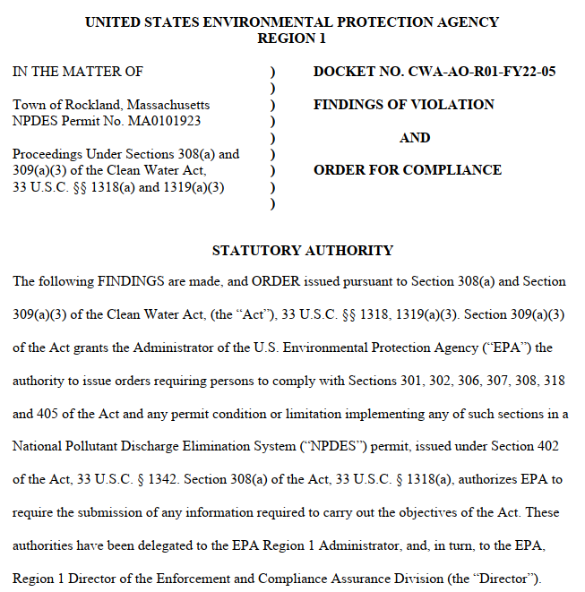
EPA Order
Reduce flows to WWTF
I/I reduction
Peak flow reduction
TP Compliance
Evaluate “Flow Shedding” options
Groundwater discharge
Alternative Surface Water Discharge

Slide 16
CWMP Summary
Phase 1
Existing conditions
Develop Study Areas – 7 total study areas
Perform wastewater needs assessment – only one study area is a “Needs Area”
Phase 2
Evaluate wastewater management alternatives for high Needs Area 1
Onsite systems
Innovative/Alternative (I/A) Systems
Decentralized WWTF
Collection system extension
Evaluate potential groundwater discharge locations
Shortlist alternatives to move into Phase 3
Notes:
MassDEP guidelines

Slide 17

CWMP Phase 3 Recommendations
Needs Area
Collection System and I/I Control
Groundwater Discharge
WWTP
Onsite septic systems
Septage Management Plan
Permit and EPA Order related needs
Age related needs
Condition related needs
Esten School for additional disposal is an option
Partnership with Union Point developers to address flow shedding from northern collection system
Permit and EPA Order related needs
Age related needs
Condition related needs
Design Build Approach

Slide 18
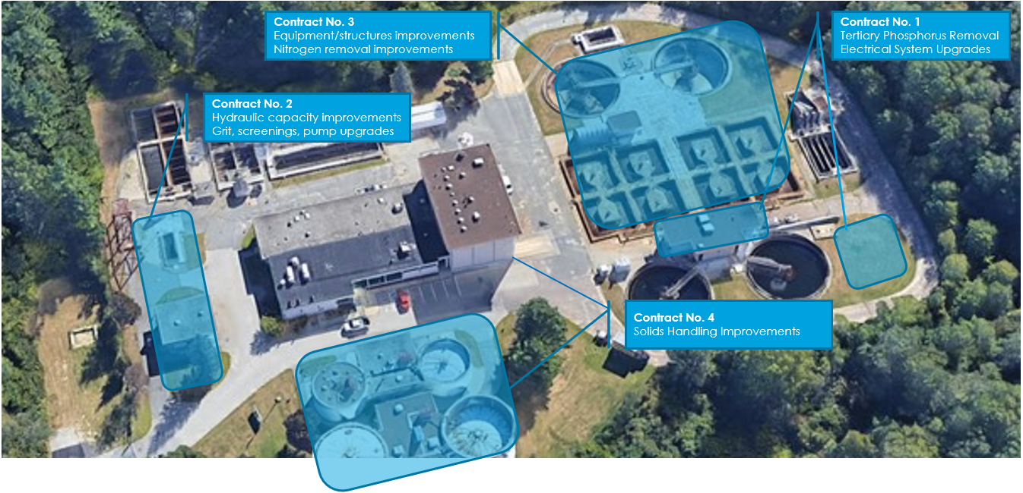
WWTP – Scope of Improvements Site Plan

Slide 19
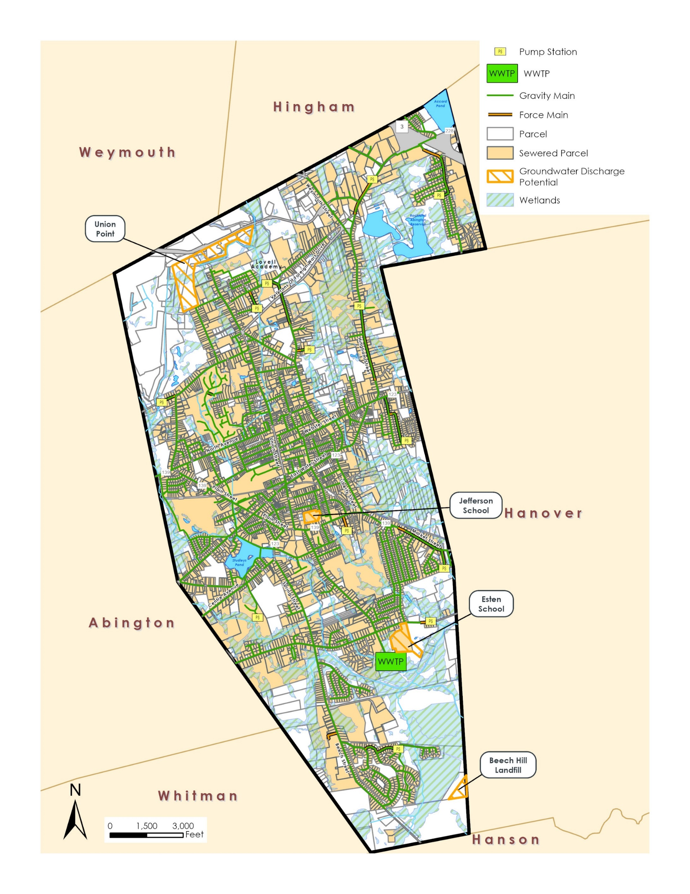
Groundwater Discharge Alternatives
Seven potential sites identified
Met with stakeholders
Shortlisted sites (two golf courses and Southern Land removed)
Union Point (reduced in size)
Jefferson School
Esten School Land
Beech Hill Landfill
Reduced site size with soil info

Slide 20
Groundwater Discharge – Potential Effluent Disposal Site Details
Site Name | Parcel Size (acres) | Usable Disposable Area (acres) | Disposal Capacity (gpd)
 |  |  | 1.5 gpd/sq ft | 4 gpd/sq ft
Beech Hill Landfill | 16 | 1.9 | 124,100 | 331,100
Esten School | 19 | 13 | 849,400 | 2,265,100
Jefferson School | 6.5 | 3.8 | 248,300 | 662,100
Union Point | 63 | 42 | 2,744,300 | 7,318,100

Slide 21
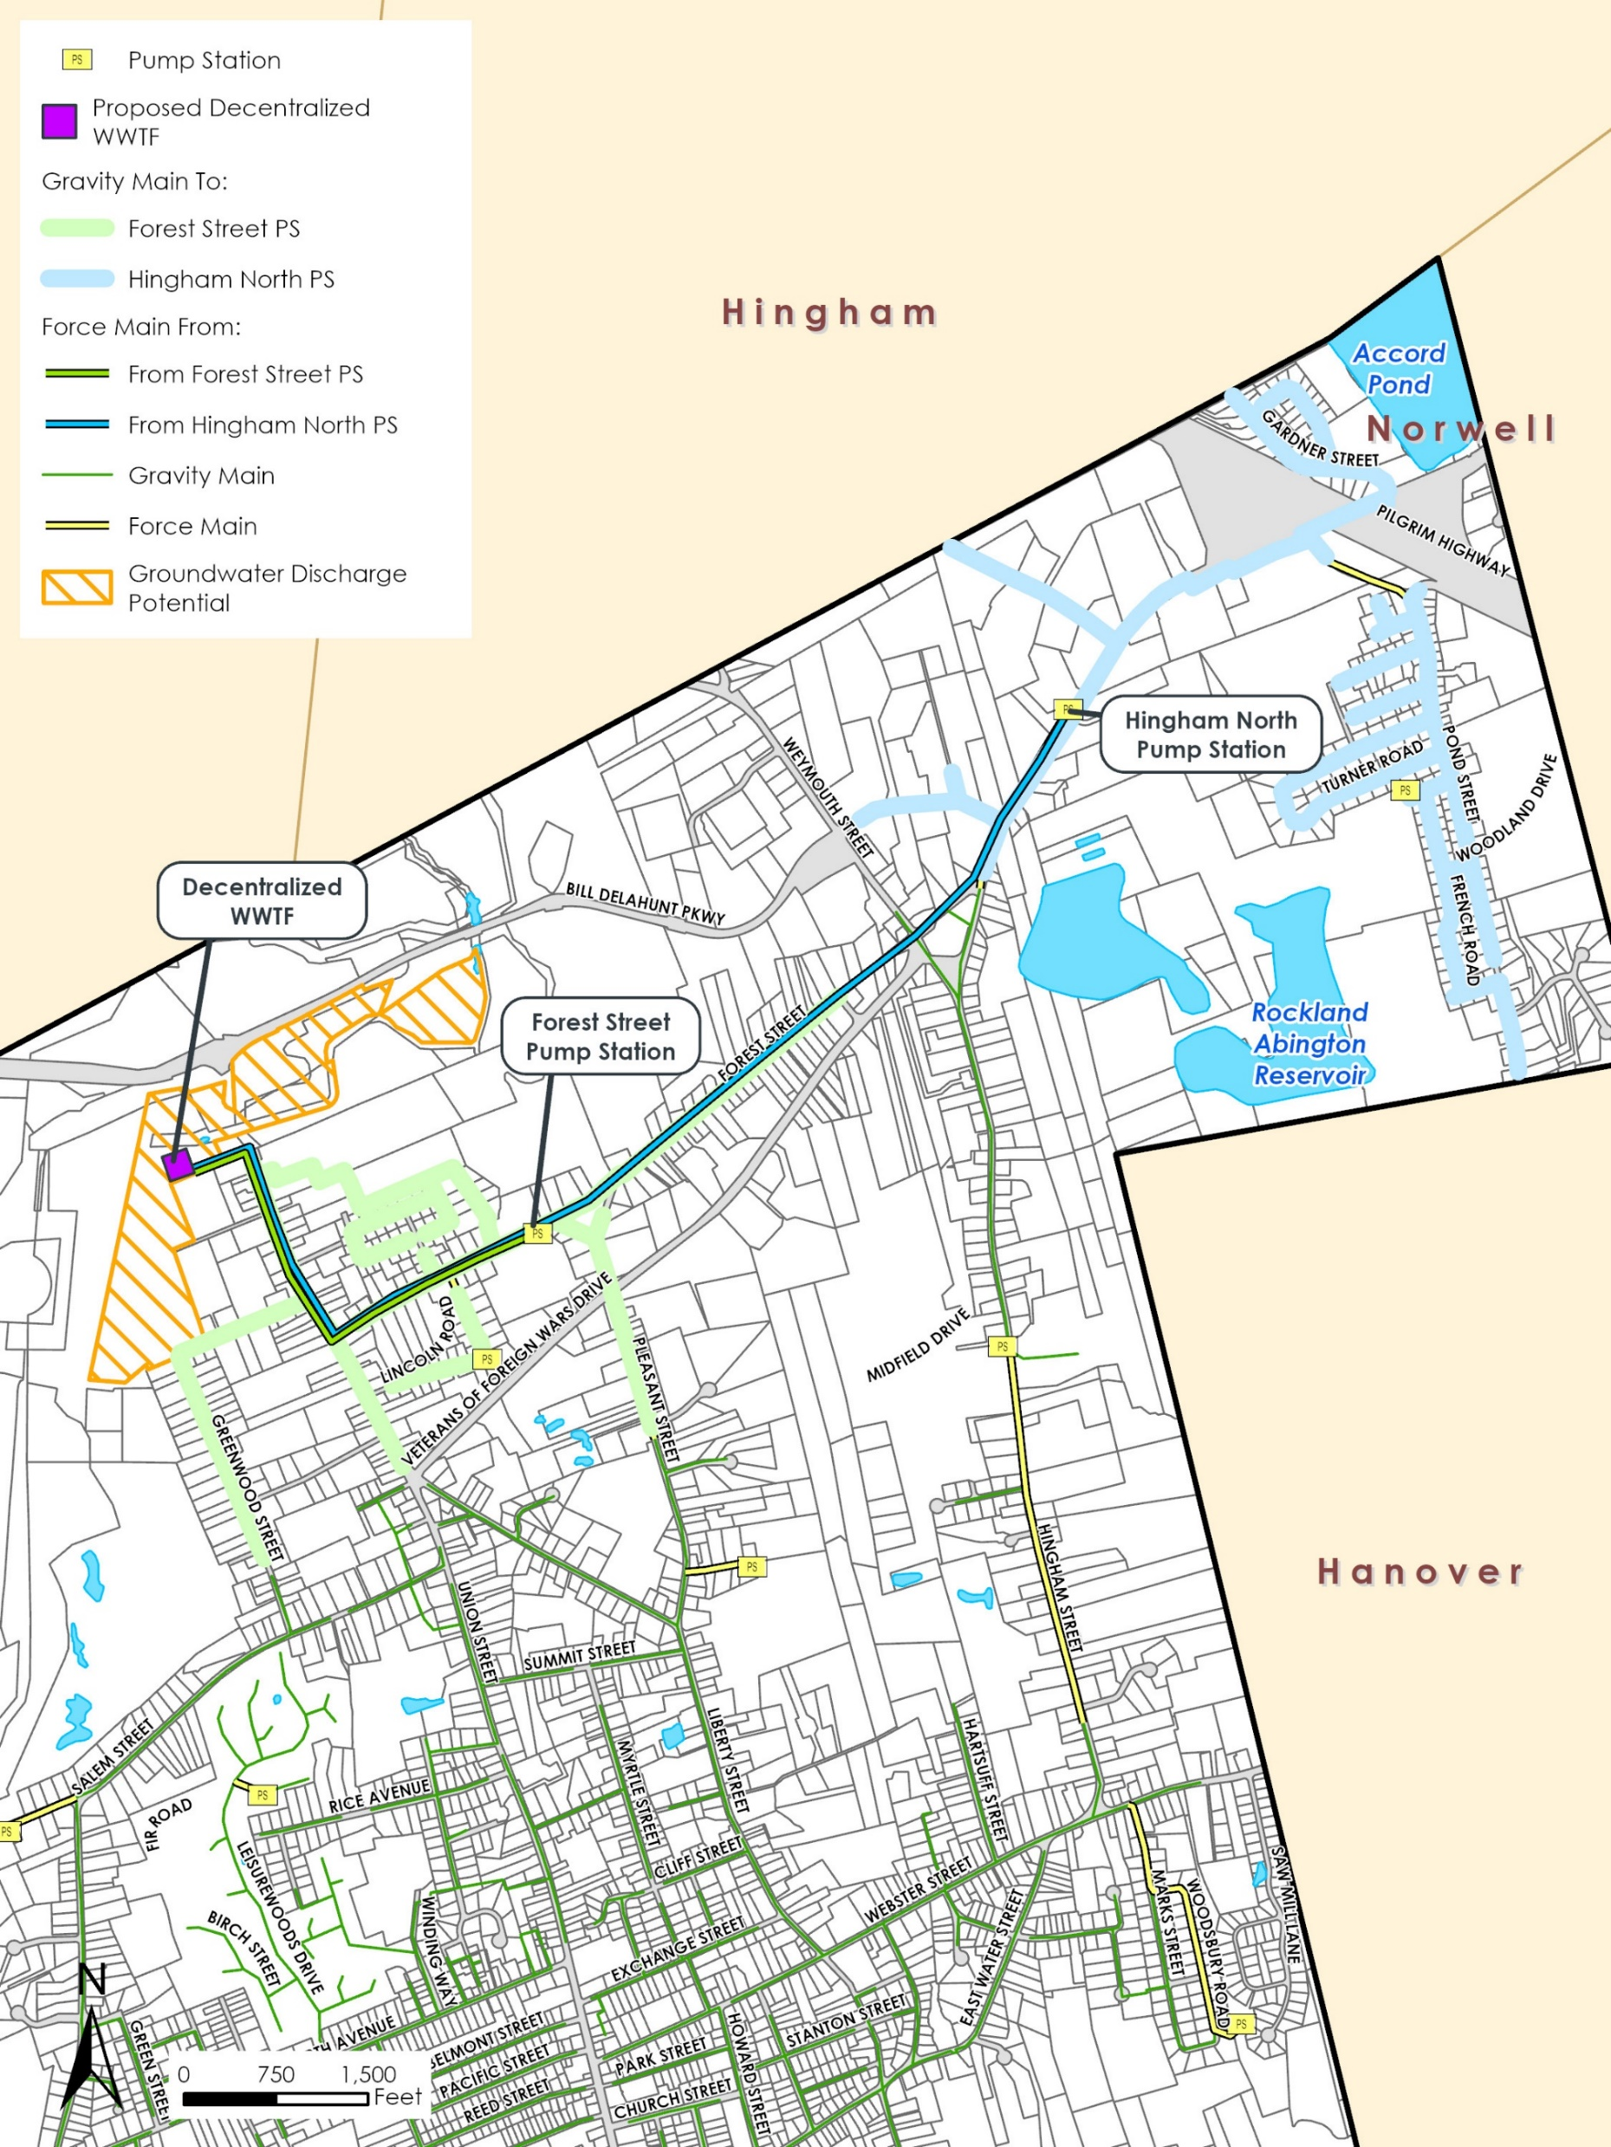
Groundwater Discharge – Flow Shedding Options
Forest Street Pump Station
Rated capacity of 400 gpm
576,000 gpd peak flow
Average daily flow shed of 240,000 gpd
Hingham North Pump Station
Rated capacity of 1,000 gpm
1,440,000 gpd peak flow
Average day flow shed of 686,000 gpd
Combination of both
926,000 average gpd shed
1,000 – 35,000 gpd additional from Needs Area 1

Slide 22
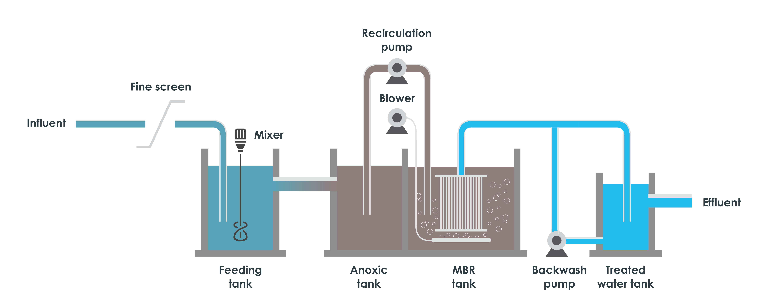
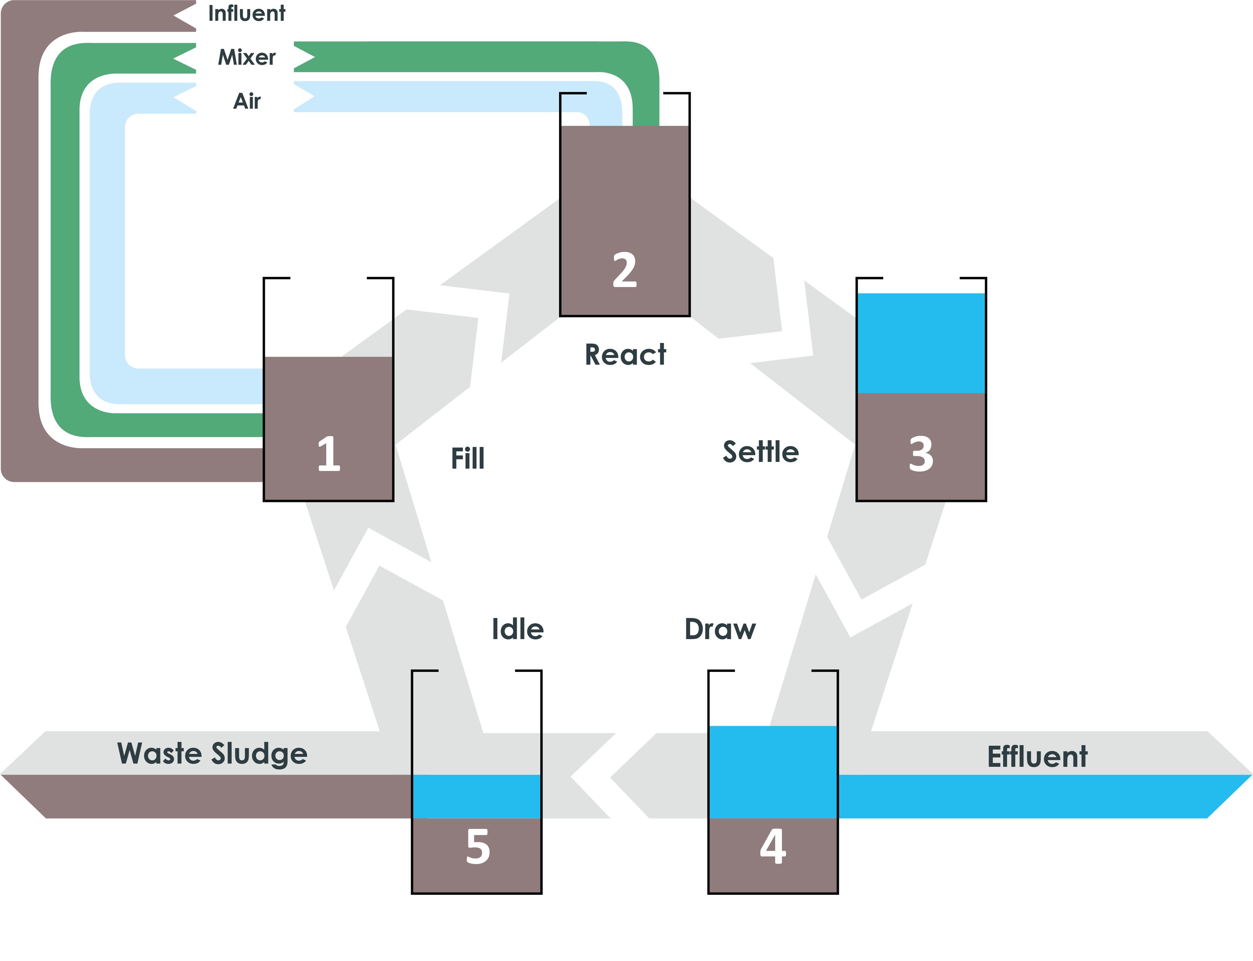
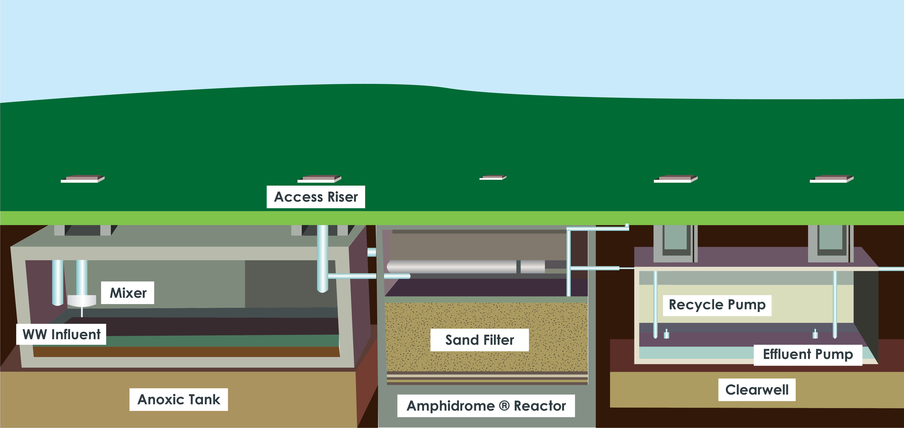
Groundwater Discharge – Flow Shedding Decentralized WWTF
Decentralized WWTF
0.5-1 MGD (larger for Union Point developer flows)
Receive flows from Forest Street and/or Hingham North Pump Station
Approximately 1 acre needed for facility
Biological treatment
Membrane Bioreactors (MBR), Sequencing Batch Reactors (SBR), or Amphidrome
Union Point Disposal Site
2.7-7.3 MGD disposal capacity based on loading rates from 1.5-4 gpd/SQFT

Slide 23
Groundwater Discharge – Decentralized System Costs - Union Point Option
 | Forest Street PS Shedding | Hingham Street, North PS Shedding | Both Pump Stations
Effluent Disposal Cost ($) | $5,900,000 | $22,200,000 | $31,100,000
Decentralized WWTF ($) | $26,500,000 | $46,300,000 | $56,500,000
Sewer Routing Cost ($) | $3,300,000 | $6,700,000 | $10,000,000
Total Costs | $35,700,000 | $75,200,000 | $97,500,000

Slide 25
Groundwater Discharge – Estimated Costs
 | 1.1 MGD Capacity | 2.7 MGD Capacity | 0.12 MGD Capacity | 0.25 MGD Capacity | 0.85 MGD Capacity
Site | Union Point |  | Beech Hill Landfill | Jefferson School | Esten School
Effluent Disposal Cost ($) | $10,700,000 | $25,700,000 | $1,800,000 | $2,900,000 | $8,400,000
Rockland WWTP Secondary Upgrades Costs ($) | $16,000,000 | $16,000,000 | $16,000,000 | $16,000,000 | $16,000,000
Sewer Routing Cost ($) | $18,500,000 | $18,500,000 | $15,000,000 | $6,100,000 | $1,900,000
Total Costs | $45,200,000 | $60,200,000 | $32,800,000 | $25,000,000 | $26,300,000

Slide 26
WWTP Upgrade Drivers – Total Phosphorous (TP) Limit
Parameter | Limitation | Sample Frequency
BOD₅ Removal | >85% | 1/month
TSS removal
Escherichia coli | Average Monthly = 126 cfu/100 mL Maximum Daily = 409 cfu/100 mL | 3/week, grab
Total Phosphorous (TP) | Average Monthly: Apr 1 - Oct 31 = 0.1 mg/L Nov 1 - Mar 31 = 1.0 mg/L Maximum Daily = Report | 2/week, 24-hour composite 2/week, 24-hour composite
Dissolved Oxygen | > 7.4 mg/L | 1/day, grab
Total Copper | Average Monthly = 12 μg/L Maximum Daily = 19 μg/L | 1/month, 24-hour composite
Total Aluminum | Average Monthly = 87.2 μg/L Maximum Daily = Report | 1/month, 24-hour composite
PFAS compounds | Maximum Daily = Report | 1/quarter composite
Notes:
Future TN limit likely

Slide 27
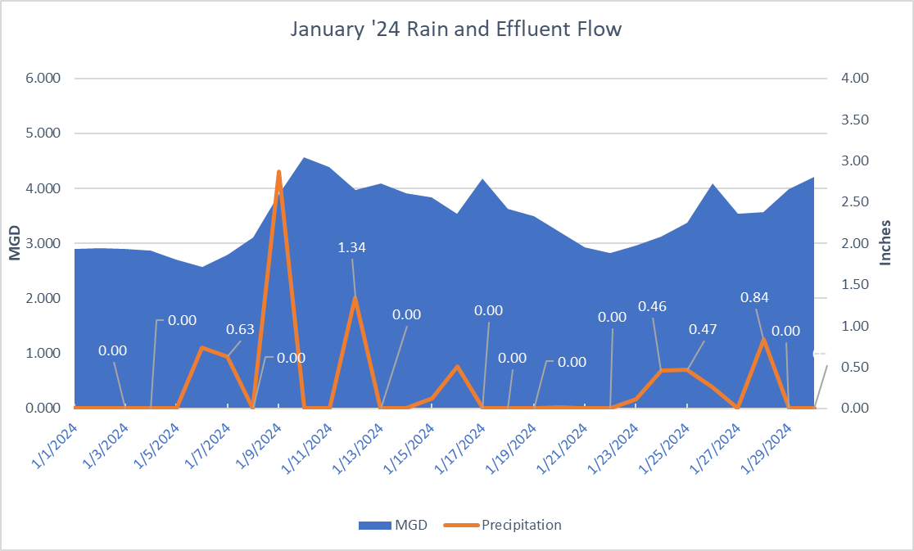
January 2024 WWTP Effluent Flows and Precipitation

Slide 28
WWTP – Design Build Phased Approach
Contract No. 1- Tertiary Treatment
Phosphorus removal
Electrical updates
Contract No. 2- Hydraulic Capacity
Alternative No. 1 - Modifications to existing facilities
Alternative No. 2 - New screening facility
Alternative No. 3 - New screening and grit facility
Contract No. 3- Miscellaneous Equipment and System Improvements
Alternative No. 1 - Immediate improvement needs
Alternative No. 2 - Process improvement and rehabilitation needs
Alternative No. 3 - Nitrogen Removal Process Improvement and Rehabilitation Needs
Contract No. 4- Solids Handling Improvements
Dewatering system
Revisiting Scope of Improvements Now – May Move Secondary Improvements to Contract No. 1

Slide 29
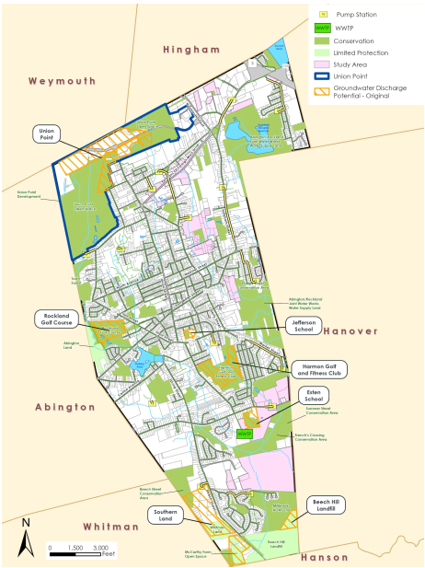
Groundwater Discharge Alternatives
Open Space
Not protected
Not wetland
Town-owned is best

Slide 30
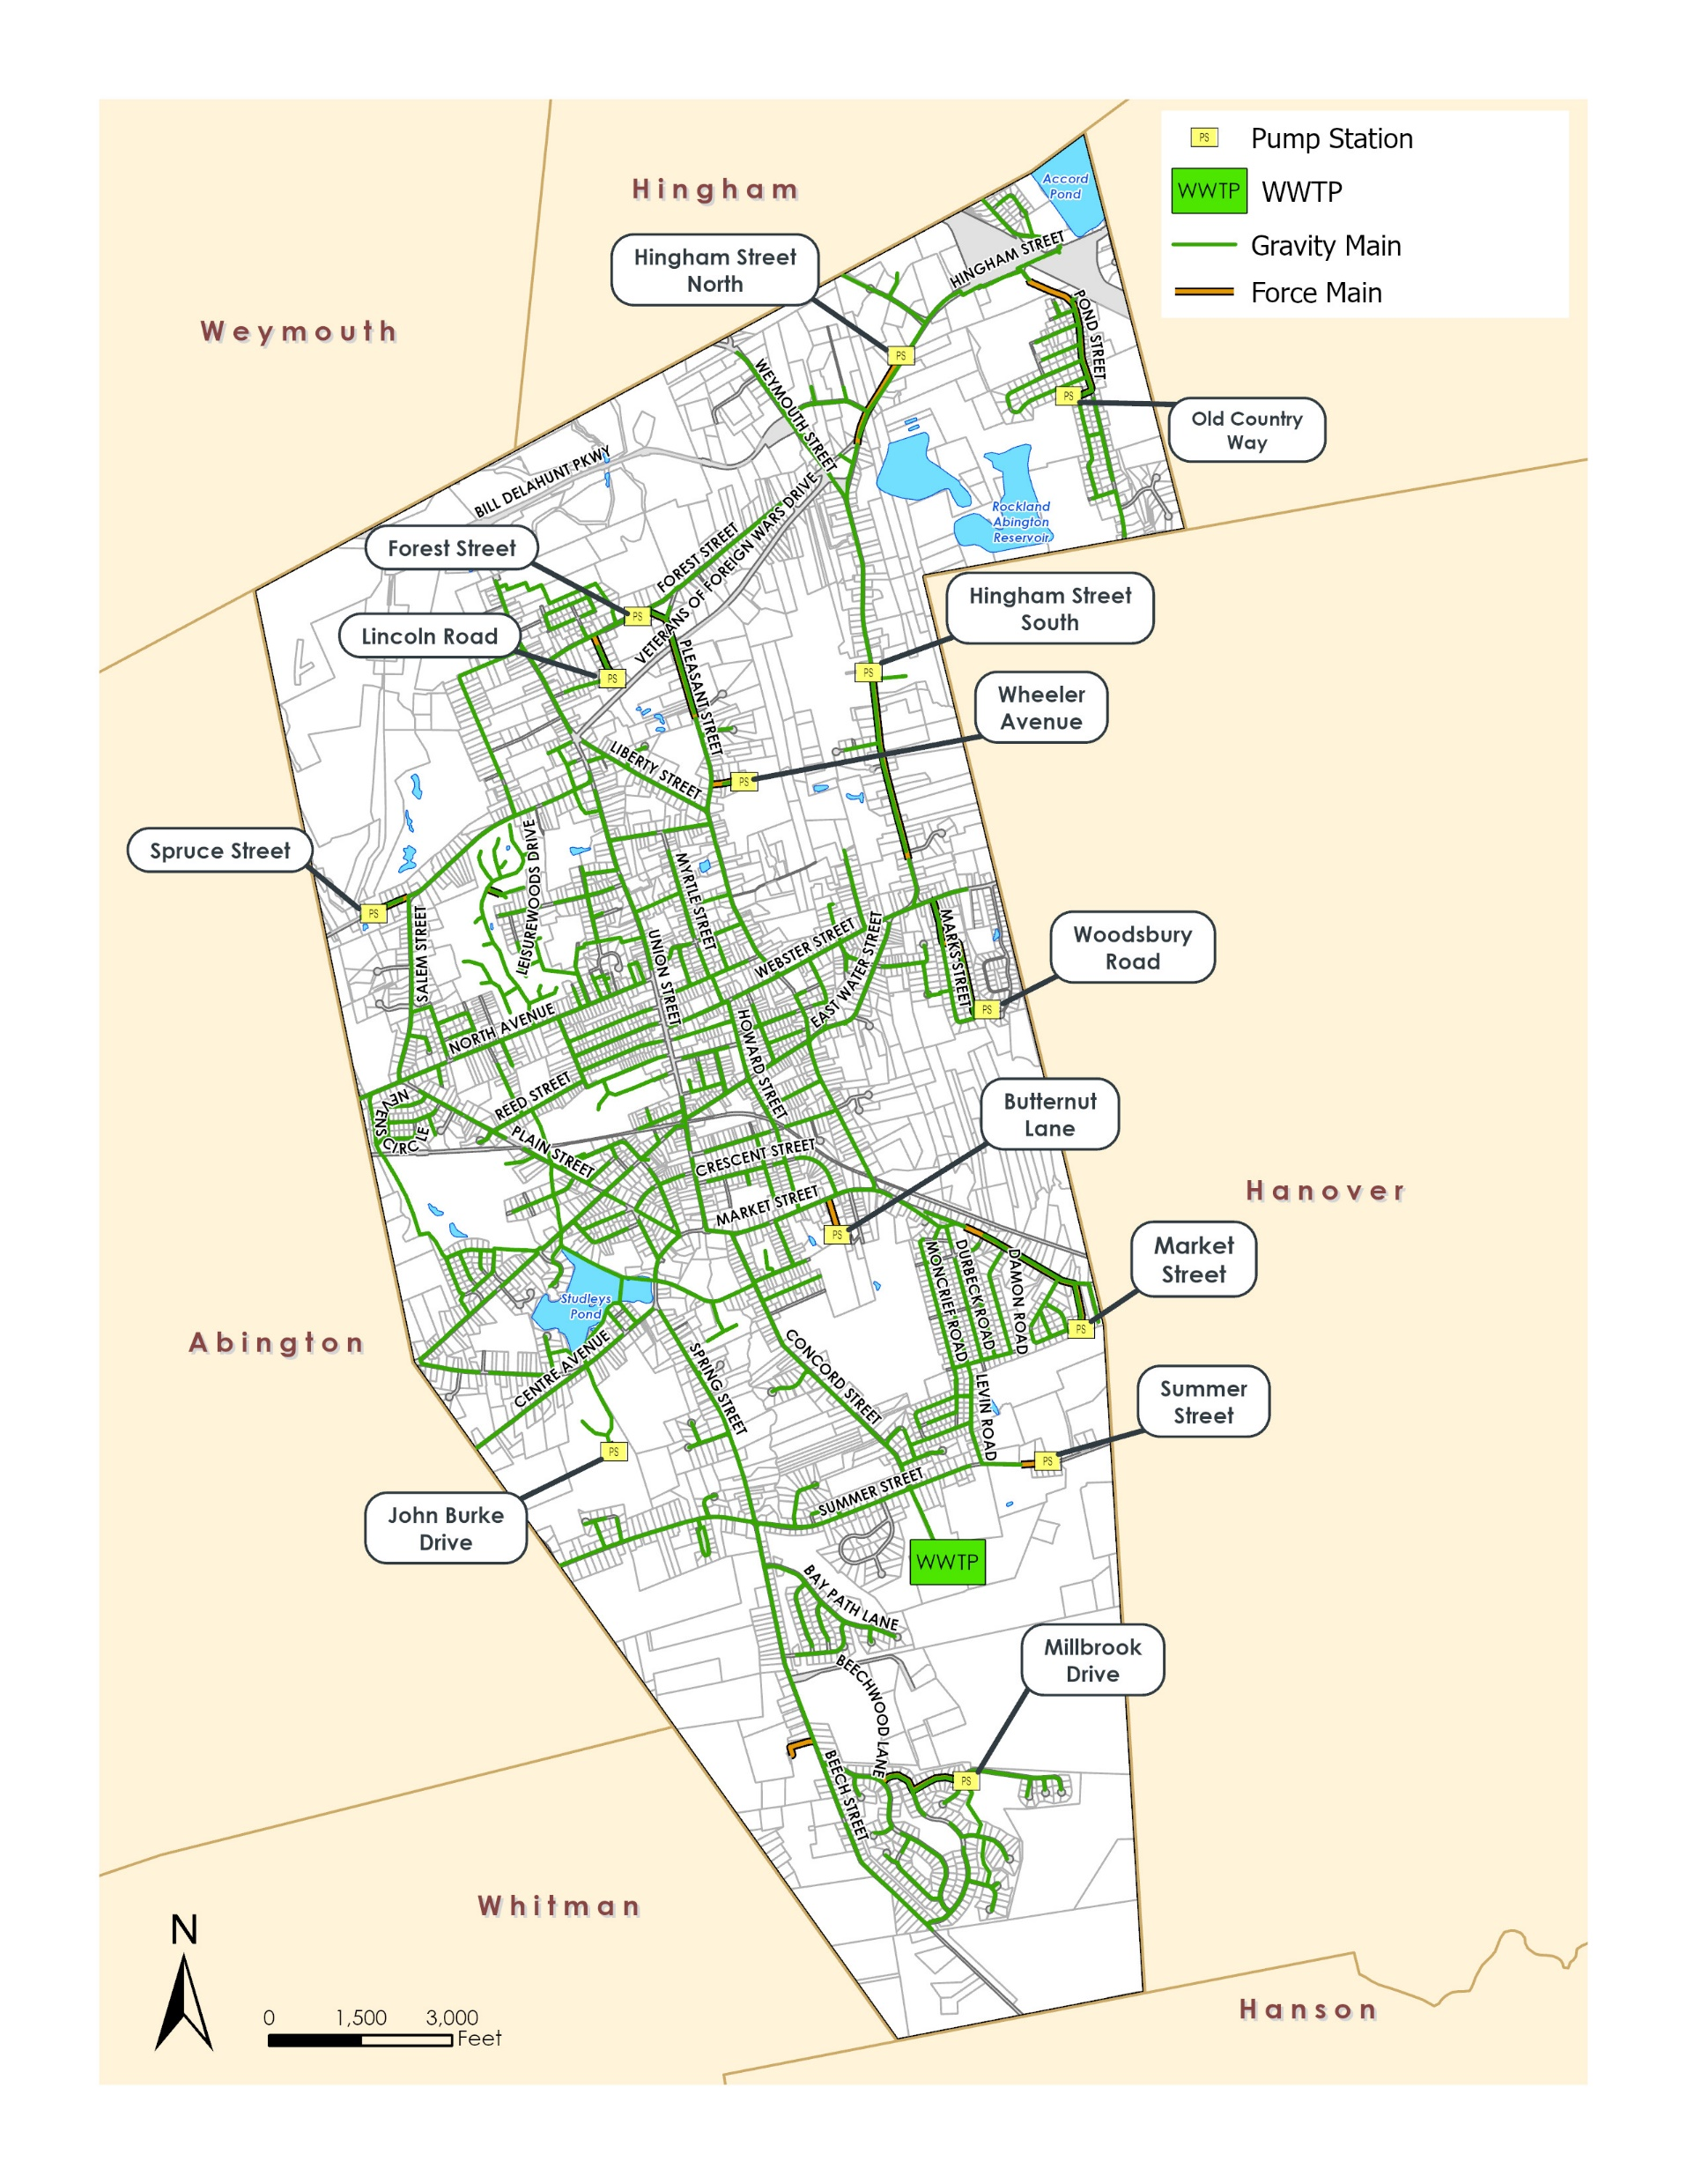
Existing Wastewater Collection System

Slide 31
WWTP Typical Schedule
Milestone | Timeline*
Appropriate Engineering Funds for Design | Annual Town Meeting, May 2023
Preliminary Design (30%) | 8 months, following Notice-to-Proceed
Preliminary Design Begins | August 2023
MassDEP SRF Project Evaluation Form (PEF) Submitted | August 2023
MassDEP SRF Intended Use Plan (IUP) Notification Draft | January 2024
Final IUP | 1 month
Final Design & Permitting | 12-14 months, beginning after Preliminary Design
Appropriate Construction Funds | Annual Town Meeting, May 2024
SRF Application Submission (90% Design) | By October 15, 2024
MassDEP Project Approval Certificate (PAC) | By December 31, 2024
100% Design and Permitting Complete | December 2024
Bidding | 4 months, after 100% Design complete
Prequalification of GCs and Subs | January 2025 (2 months)
Filed Sub-bids | March 2025 (4 weeks)
GC Bids | April 2025 (6 weeks)
Construction* | 30 months, beginning after GC selected and NTP
Contractor Notice-to-Proceed | By June 30, 2025
Substantial Completion | December 2027
Final Completion | February 2028
One-Year Warranty Period | December 2028
*Extended construction period expected based on lead times for equipment such as generator, MCCs, switchgear, etc.
Permit Total Phosphorus Compliance Date is February 2024 to complete construction

Slide 32
WWTP Recommended Improvements Cost Estimate
Project Component | Cost
Civil | $1,379,000
Architectural | $2,993,000
Structural | $2,767,000
Process | $11,063,000
HVAC/Plumbing | $1,057,000
Instrumentation | $1,085,000
Electrical | $5,416,000
Specials | $370,000
Construction Factors | $4,727,000
Subtotal | $30,858,000
Design Contingency | $6,172,000
Construction Contingency | $2,190,000
Inflation To Midpoint of Construction | $6,728,000
Estimated Construction Cost | $45,948,000
Engineering Services | $8,752,000
Materials Testing | $219,000
Legal/Administrative | $428,000
Financing | $837,000
Total Project Cost | $56,163,000*
Recent bidding and construction climate has led to increased project costs and high inflation – planning value of $72 million is more realistic

Slide 33
Reasons for the CWMP
Town-Wide Planning
20-year period
Unsewered areas
Proposed developments
Key areas of protection and environmental concern
Wastewater Collection System
Existing pipes
Pump stations
Capacity
I/I Control
Wastewater Treatment Plant
New NPDES Permit
Aging equipment
Current building code requirements
Capacity
Project Financing
0/2 % SRF Loan
20 or 30-year Loan
Other requirements
Town, Veolia, EPA and MassDEP involvement throughout project: Workshops, Meetings, Reviews
Notes:
Define and explain I/I
Define and explain NPDES
Define and explain SRF funding
Define MassDEP

Slide 34

Rockland Pump Stations

Slide 35
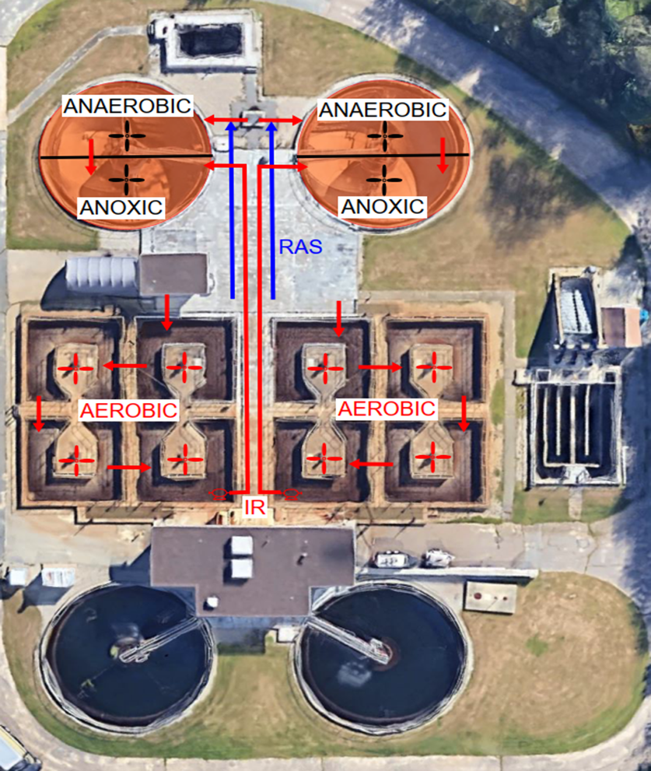
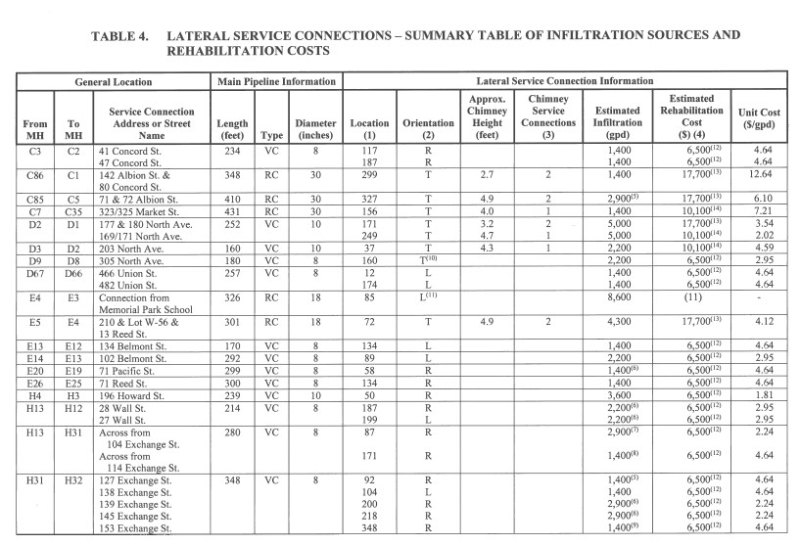
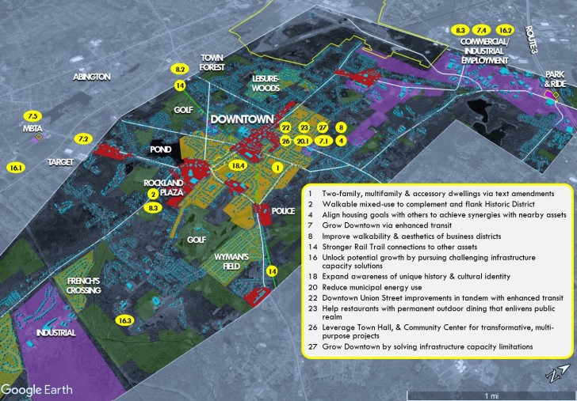
Previous Planning/Studies/Projects
WWTP Assessment WP evaluated the WWTP and provided recommendations to improve the WWTP, including secondary and tertiary treatment solutions. Completed Spring 2021.
Infiltration/Inflow (I/I) and Sewer System Evaluation Survey (SSES) I/I and SSES work previously completed and ongoing. 2021 SSES included recommendations to reduce I/I. Sewer rehabilitation project and flow monitoring completed in Summer 2023
Master Plan of 2030 The Town of Rockland’s roadmap for planning from 2020 to 2030 to achieve the Town’s long-term goals and objectives for the community.
Notes:
Other resources include the open space plan, NPDES permit, Town reports, ASR Water Reports, Watershed Action Plans

Slide 36
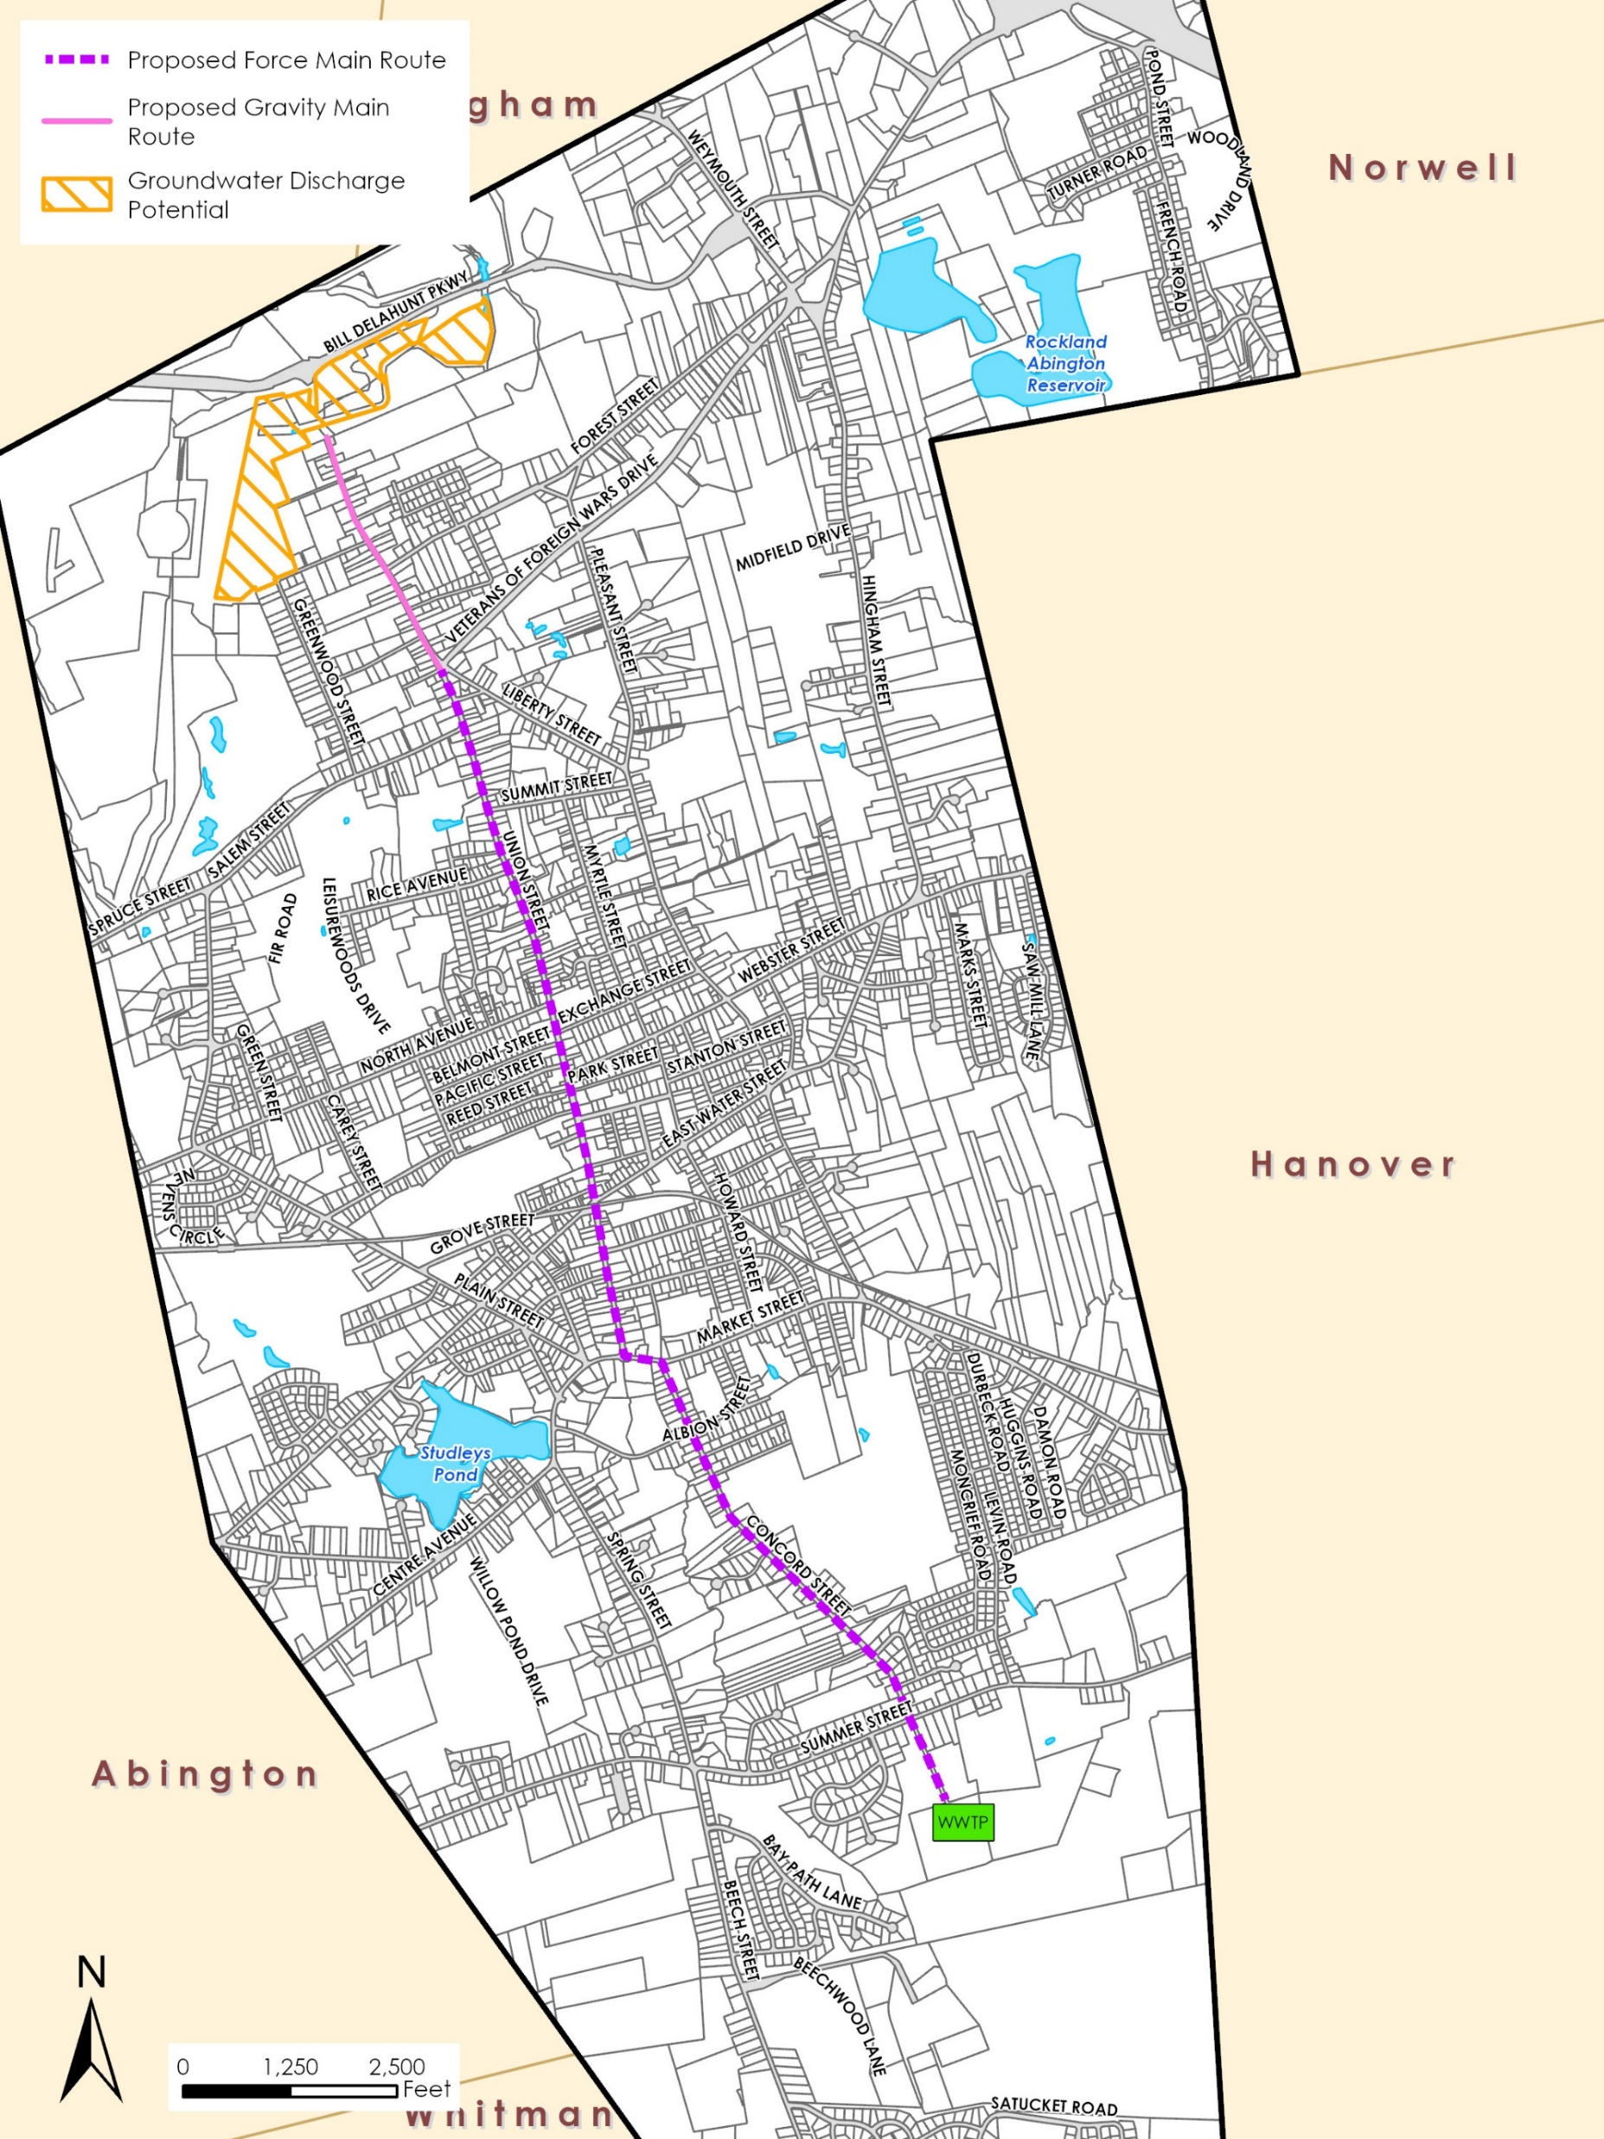
Groundwater Discharge – Effluent Disposal: Union Point

Slide 37
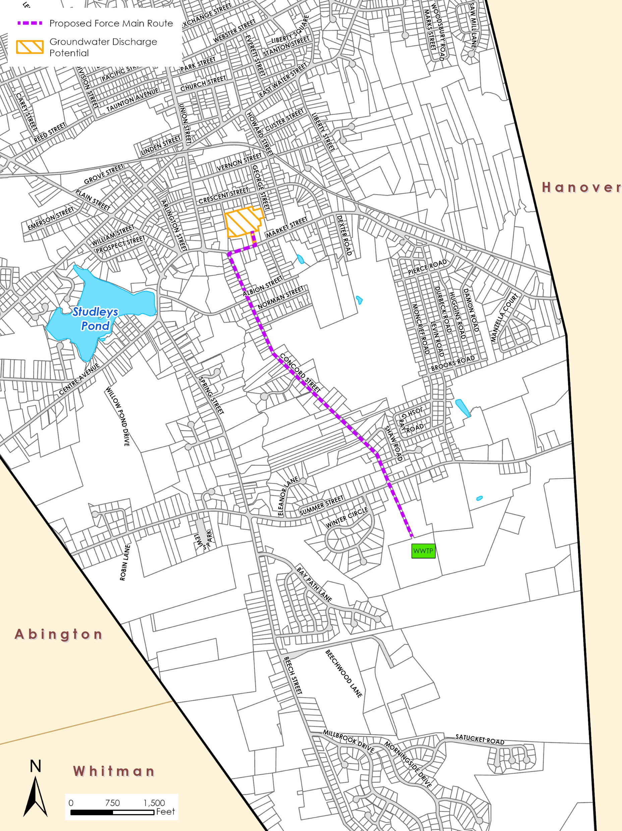
Groundwater Discharge – Effluent Disposal: Jefferson School

Slide 38
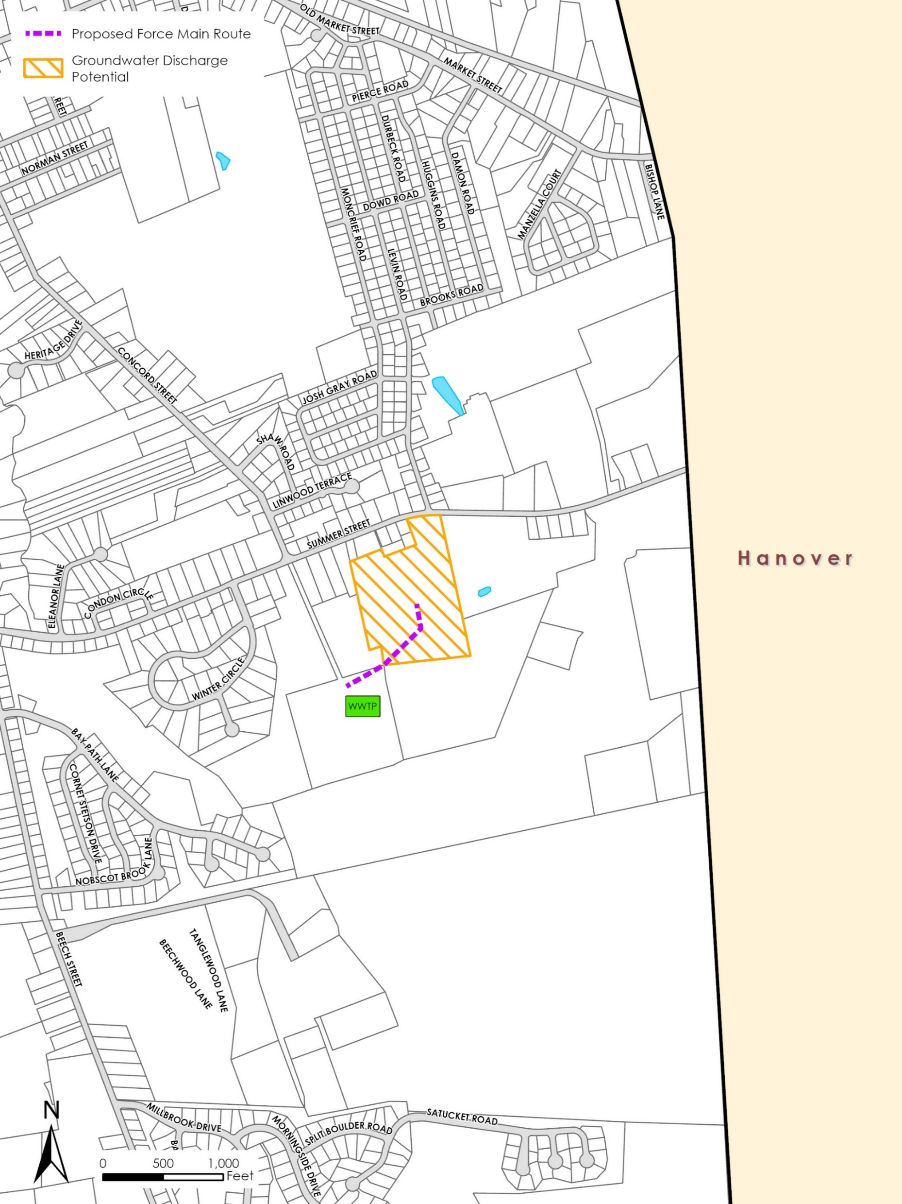
Groundwater Discharge – Effluent Disposal: Esten School

Slide 39
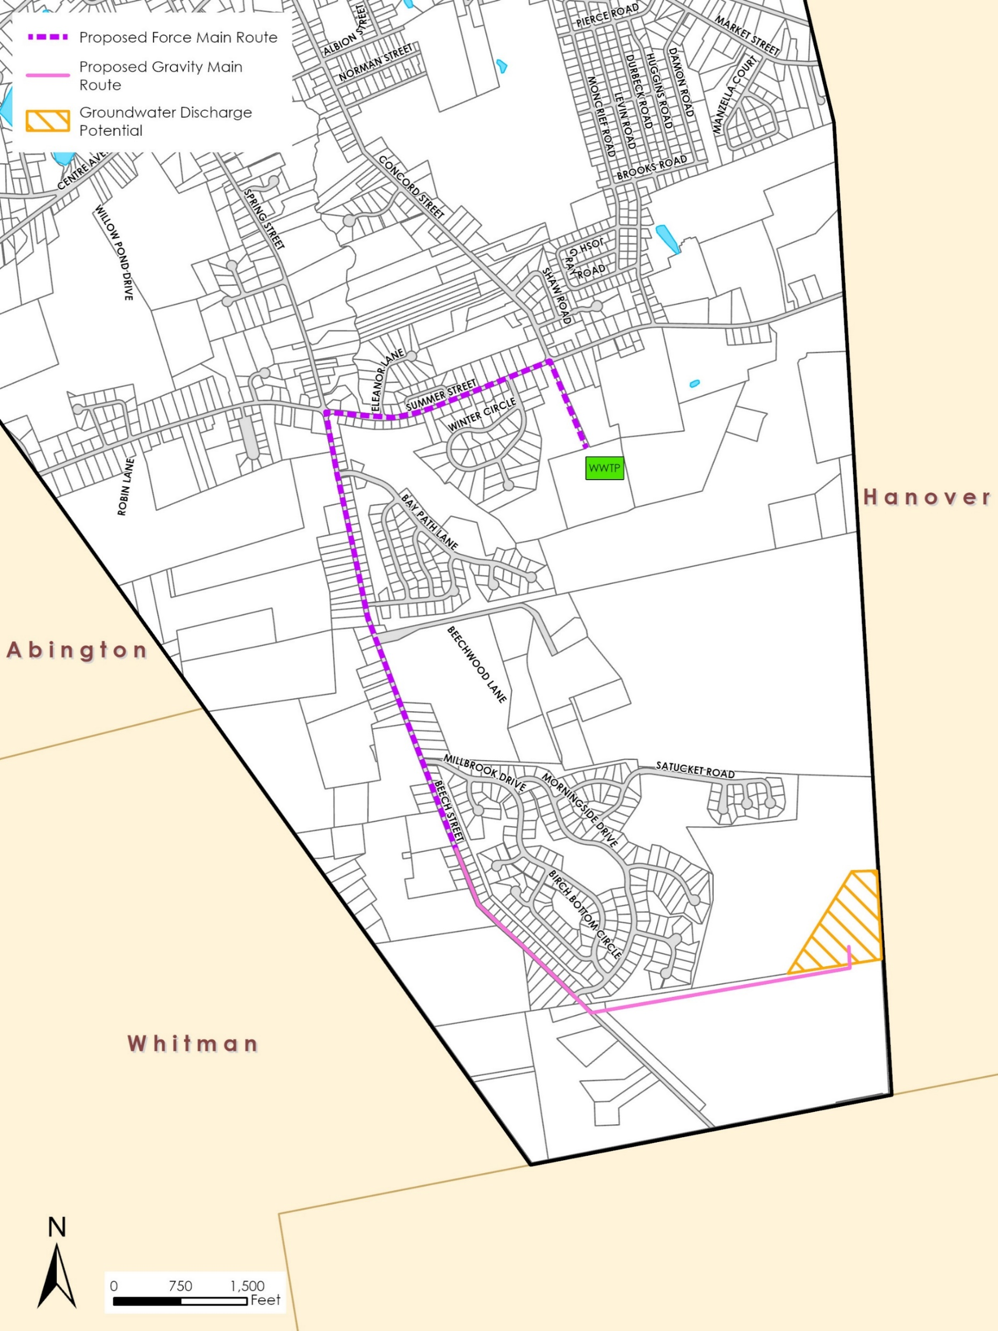
Groundwater Discharge – Effluent Disposal: Beech Hill Landfill

Slide 40
Implementation Plan – Years 1-10
Item | Total Est. Costs Per Item | Plan Year
 |  | 1 | 2 | 3 | 4 | 5 | 6 | 7 | 8 | 9 | 10
 |  | 2024 | 2025 | 2026 | 2027 | 2028 | 2029 | 2030 | 2031 | 2032 | 2033
Collection System | $6,741,000 | $150,000 | $155,000 | $160,000 | $200,000 | $1,500,000 | $170,000 | $175,000 | $180,000 | $220,000 | $1,500,000
Pump Stations
Forest Street | $964,000 |  |  |  |  | $964,000
Lincoln Road | $618,000 |  |  |  |  | $618,000
Wheeler Avenue | $1,163,000 |  |  |  | $1,163,000
Summer Street | $1,170,000 |  |  |  | $1,170,000
John Burke Drive | $1,163,000 |  |  |  | $1,163,000
Hingham Street – North | $1,628,000 |  |  |  |  |  | $1,628,000
Hingham Street – South | $1,784,000 |  |  |  |  |  | $1,784,000
Market Street | $864,000 |  |  | $864,000
Woodsbury Road | $786,000 |  |  | $786,000
Millbrook Drive | $765,000 |  |  |  |  | $765,000
Old Country Way | $765,000 |  | $765,000
Spruce Street | $615,000
Butternut Lane | $618,000
WWTP | $72,000,000 | $1,000,000 | $1,115,000 | $15,512,000 | $641,000 | $640,000 | $9,395,000 | $1,661,000 | $1,661,000 | $24,360,000 | $961,000
Total | $91,644,000 | $1,150,000 | $2,035,000 | $17,322,000 | $4,337,000 | $4,487,000 | $12,977,000 | $1,836,000 | $1,841,000 | $24,580,000 | $2,461,000

Slide 41
Implementation Plan – Years 11-20
Item | Plan Year
 | 11 | 12 | 13 | 14 | 15 | 16 | 17 | 18 | 19 | 20
 | 2034 | 2035 | 2036 | 2037 | 2038 | 2039 | 2040 | 2041 | 2042 | 2043
Collection System | $191,000 | $197,000 | $203,000 | $240,000 | $1,500,000 | $250,000 | $250,000 | $250,000 | $250,000 | $2,000,000
Pump Stations
Forest Street
Lincoln Road
Wheeler Avenue
Summer Street
John Burke Drive
Hingham Street – North
Hingham Street – South
Market Street
Woodsbury Road
Millbrook Drive
Old Country Way
Spruce Street |  |  |  |  |  |  |  |  |  | $615,000
Butternut Lane |  |  |  |  |  |  |  |  |  | $618,000
WWTP | $961,000 | $14,093,000
Total | $1,152,000 | $14,290,000 | $203,000 | $240,000 | $1,500,000 | $250,000 | $250,000 | $250,000 | $250,000 | $3,233,000

