Slide 1
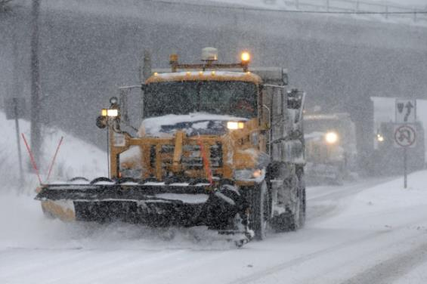

Winter Safety Issues
Specializing in Workers’ Compensation

Slide 2
Agenda
Specializing in Workers’ Compensation
Most frequent winter related injures
Cold Weather Safety
Snow Removal
Equipment Safety
Unusual Incidents

Slide 3
Most Frequent Injuries
Specializing in Workers’ Compensation
Slips & Falls:
Mounting/dismounting equipment
Walking/running
Slippery surfaces
Strains & Sprains
Snow shoveling/removal
Plow installation/removal

Slide 4
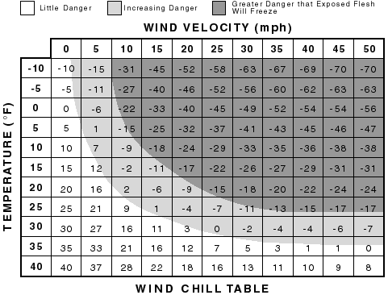
Cold Weather Safety
Specializing in Workers’ Compensation

Slide 5
Cold Weather Safety
Specializing in Workers’ Compensation
Wear at least three layers: layer 1 breaks the wind, layer 2 absorbs sweat, layer 3 draws sweat off the body.
Keep a change of clothing available, should one set get wet.
Pay special attention to your feet hands head and face. Keep your head covered.
Wear footgear that protects against cold and dampness.

Slide 6
Cold Weather Safety
Specializing in Workers’ Compensation
Consider an on-site source of heat.
For prolonged exposures to 20⁰ F or less, consider a heated shelter.
Shield work areas from drafty or windy conditions.
Do not sit or kneel on cold unprotected surfaces.

Slide 7
Cold Weather Safety
Specializing in Workers’ Compensation
Take extra work breaks as necessary
Avoid activities that lead to heavy perspiration
Work indoors if possible during the coldest days; when outside, selects the warmest part of the day.
Prevent dehydration by drinking warm, sweet, caffeine-free, non-alcoholic drinks or soup.
Avoid working alone in very cold weather. Use a buddy system.

Slide 8
Cold Weather Safety
Specializing in Workers’ Compensation
Recognize the signs and symptoms of cold weather injuries:
Frostbite
Hypothermia
Fatigue/reduced awareness

Slide 9
Snow Removal - Shoveling
Specializing in Workers’ Compensation
Concerns related to shoveling:
Heart attack
Strains & sprains
Slips & falls

Slide 10
Snow Removal - Shoveling
Specializing in Workers’ Compensation
Heart Attack:
Over the age of 40, or inactive, should be especially careful.
History of heart trouble, do not shovel without a doctor’s permission.
Do not shovel after eating or while smoking.
Take it slow!

Slide 11
Snow Removal - Shoveling
Specializing in Workers’ Compensation
Strains & Sprains:
Warm up & stretch.
Lift with your legs, not your back.
Don’t pick up too much at once.
Use a long handled shovel.

Slide 12
Snow Removal - Shoveling
Specializing in Workers’ Compensation
Slips & Falls:
Proper footwear.
Move slowly -- shuffle.
Consider using ice creepers.
Use a long handled shovel.

Slide 13
Snow Removal - Shoveling
Specializing in Workers’ Compensation
Fall Protection:
Provide Fall Protection equipment to workers who go onto roofs.
Guard skylights.
Mark roof drains, and vents that could trip workers
Monitor weight load on roof.

Slide 14
Snow Removal - Plowing
Specializing in Workers’ Compensation
Equipment in good order and serviceable.
Employees familiar with equipment operation.
Operators familiar with routes and road contours.
Problem areas from previous years.
Safe snow plow installation.

Slide 15
Snow Removal – Other Areas
Specializing in Workers’ Compensation
Labeled bins containing sand and ice melting chemicals
Outdoor stairways
Walkways
Parking lots
Additional mats – entrances and exits
Frequent cleanup – water and sand tracked into facilities

Slide 16
Snow Removal – Salt or Sand?
Specializing in Workers’ Compensation
Salt:
Can eliminate icy conditions
Cannot be used in some areas
Not generally effective under 15ºF
Sand:
Provides traction
No melting
May sink below surface – reduced effectiveness
Typically a mixture is most effective

Slide 17
Snow Removal – Wet Floor Cleanup
Specializing in Workers’ Compensation
Encourage immediate reporting and cleanup
Place spill equipment in convenient locations
Pads
Paper towels
Pop up wet floor signs

Slide 18
Snow Removal - Building Entrances
Specializing in Workers’ Compensation
Walk off mats
Water absorbent
Beveled edges
Continuous
Large enough for several steps
Secure and adjusted daily
Replaced when saturated
Slip resistant flooring

Slide 19
Equipment Safety
Specializing in Workers’ Compensation
3 Point Contact:
2 hands & 1 foot.
2 feet & 1 hand.
Always face equipment when entering cab.
Place carried items in cab first.
NEVER jump from equipment!

Slide 20
Snow Removal - Plowing
Specializing in Workers’ Compensation
Equipment in good order and serviceable.
Employees familiar with equipment operation.
Operators familiar with routes and road contours.
Problem areas from previous years.
Safe snow plow installation.

Slide 21
Unusual Incidents
Specializing in Workers’ Compensation
Crushing injuries
Plow blade removal

Slide 22
Questions & Discussion
Specializing in Workers’ Compensation

